Slide 1
Year 6 SATs
Parents’ Meeting
The Canons CE Primary School

Slide 2
WHAT ARE SATS AND WHY DO CHILDREN TAKE THEM?
S – Statutory
A - Assessment
T - Tests
End of Key Stage measure of attainment and
pupil progress.
KS2 – Year 6

Slide 3
What are children tested on?
English – reading, spelling, grammar and punctuation
Mathematics 2 x reasoning papers and arithmetic paper

Slide 4
2024 SATs results
Subject | 2024 National Results | 2024 The Canons Results
Maths | 74% | 88%
Reading | 75% | 85%
Writing | 72% | 82%
GPS | 73% | 84%

Slide 5
MATHS

Slide 6
Arithmetic Maths test – Paper 1
40 marks on calculations-lasting 30 mins-which cover the four rules, adding/subtracting/multiplying/dividing fractions, calculating percentages, working with decimals numbers.
Lots of experience –practised and reviewed the key skills to complete the test.
How to help at home: Any work on times tables or practise calculations in the four operations. Internet games on calculation speed and number knowledge. Completion of practice questions.

Slide 7
What is being tested
Children are tested on the following:
Addition
Subtraction
Multiplication (including long multiplication)
Division (including long division)
Decimal numbers (various forms)
Percentages
Fractions (fractions in various forms)
BODMAS
Missing numbers in calculations
Squaring and cubing numbers

Slide 8
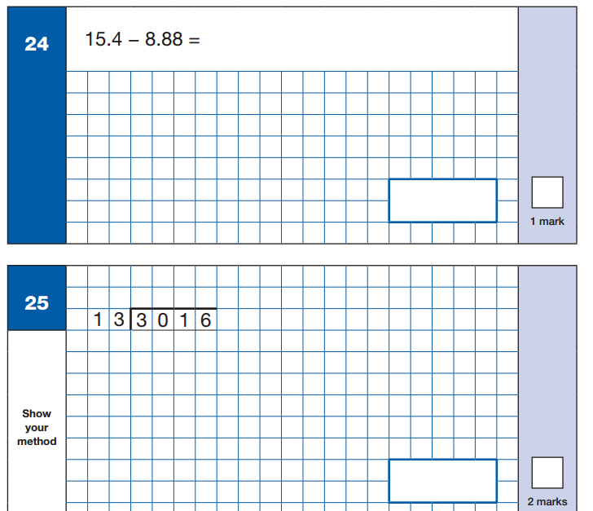
Sample Questions
Maths Paper 1: Arithmetic

Slide 9
Reasoning Maths Papers
Paper 2 and Paper 3 – Each of 40 minutes.
Children are tested on how they reason questions through and use their maths knowledge to access a mathematical problem.
Some questions have more than one step and the children must solve each of the steps.

Slide 10
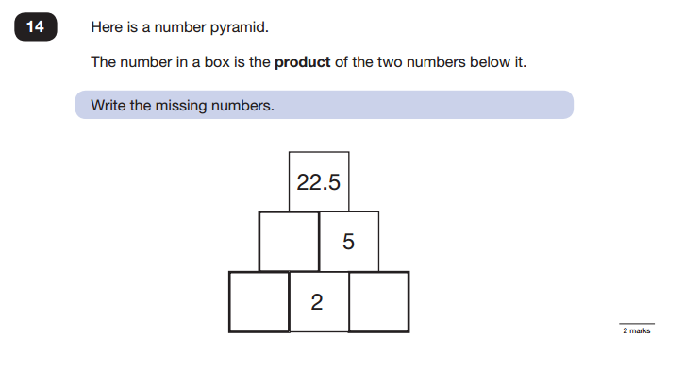
Sample Questions
Maths Paper 2 / Paper 3 : Reasoning

Slide 11
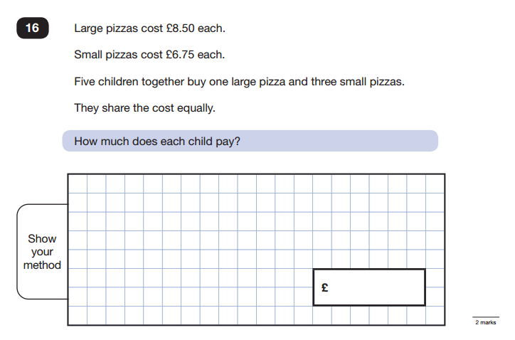
Sample Questions
Maths Paper 2 / Paper 3 : Reasoning

Slide 12
English

Slide 13
Reading
The Reading Test consists of a single test paper with three unrelated reading texts.
Children are given 60 minutes in total, which includes reading the texts and answering the questions.
A total of 50 marks are available.
Questions are designed to assess the comprehension and understanding of a child’s reading.
Some questions are multiple choice or selected response, others require short answers and some require an extended response or explanation.
Helping at home – Children to read class library book which is targeted at the correct level. Encourage children to talk about the book and discuss characters, actions etc
The Reading Test consists of a single test paper with three unrelated reading texts.
Children are given 60 minutes in total, which includes reading the texts and answering the questions.
A total of 50 marks are available.
Questions are designed to assess the comprehension and understanding of a child’s reading.
Some questions are multiple choice or selected response, others require short answers and some require an extended response or explanation.

Slide 14

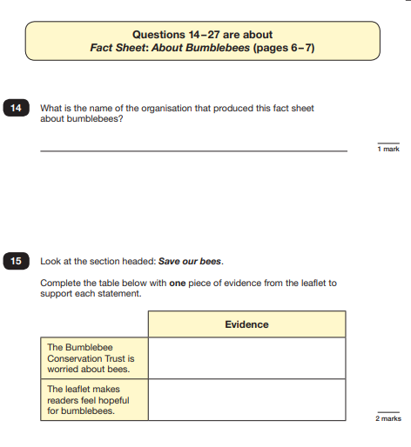
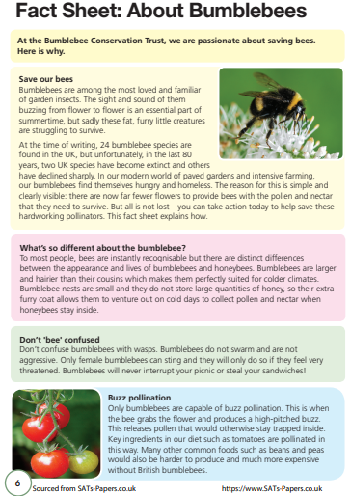

Slide 15
Spelling, Punctuation and Grammar
A Spelling test is administered containing 20 words, lasting approximately 15 minutes.
A separate test is given on Punctuation, Vocabulary and Grammar
This test lasts for 45 minutes and requires short answer questions, including some multiple choice.
Marks for these two tests are added together to give a total for Spelling, Punctuation and Grammar.
A Spelling test is administered containing 20 words, lasting approximately 15 minutes.
A separate test is given on Punctuation, Vocabulary and Grammar
This test lasts for 45 minutes and requires short answer questions, including some multiple choice.
Marks for these two tests are added together to give a total for Spelling, Punctuation and Grammar.
Children have been working through these skills in class and have been exposed to the vocabulary.

Slide 16
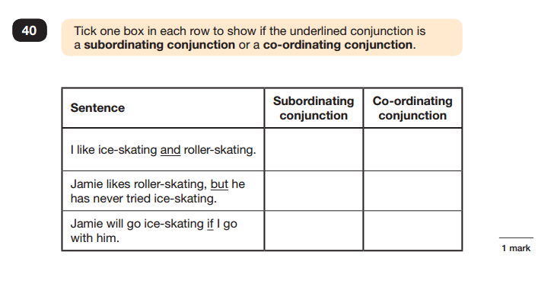
Sample Questions
Grammar, Punctuation and Spelling Paper 1

Slide 17
Spelling
Children will have 20 spellings following patterns and formations taught throughout key stage 2.
Spelling 18: The word is tongue. I burnt my tongue on the hot soup. The word is tongue.
Spelling 19: The word is accidentally. Sarah accidentally spilled water all over the table. The word is accidentally.
Spelling 20: The word is deceive. The criminal tried to deceive the police. The word is deceive.

Slide 18
Marks available in each test
English grammar, punctuation and spelling Paper 1: | 50 marks | 70 marks
English grammar, punctuation and spelling Paper 2: spelling English Reading | 20 marks 50 marks
Mathematics Paper 1: arithmetic | 40 marks | 110 marks
Mathematics Paper 2: reasoning | 35 marks
Mathematics Paper 3: reasoning | 35 marks

Slide 19
Scaled Scores- what is meant by scaled scores?
When the children have completed their SATS they will receive a RAW score and a scaled score. The scaled score shows if the child is:
Working towards year 6 standards
At year 6 standards
At greater depth
A scaled score of less than 100 represents that the child is till working towards end of year 6 expectations
A scaled score of between 100 and 109 represents that the child is working at expected level
A scaled score of between 110 and 120 represents that they are at greater depth and have achieved an advanced understanding.
E.g. in maths if a child scores 57 out of 110 it generates a scaled score of 100 meaning that child has reached the expected standard.
All scaled scores can be found on the governments education website.

Slide 20
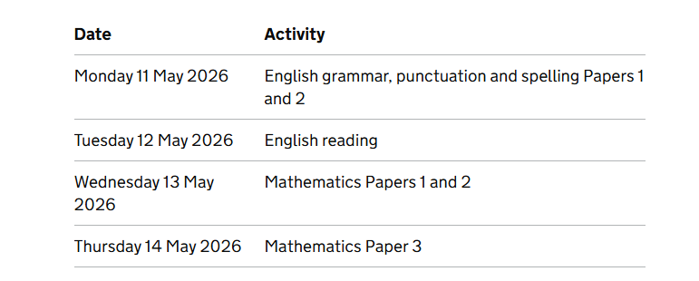
When will the tests take place?

Slide 21
Leading up to the tests
Breakfast clubs will be in operation during the 3 weeks leading up to SATs. They are not compulsory. They will start on Monday 20th April– for 3 weeks – ending Friday 8th May.
Children arrive in school for 8.10 through the front office.
We serve them breakfast and then start an extra lesson at 8.30.
Classes are mixed and we allocate children to different groups according to their needs.

Slide 22
Arrangements for the day of the test
The tests will take place in classrooms for most children. The children will have completed a number of practice rounds and will be familiar with the set up and the place in which they sit.
We ask children to come into school and have breakfast – timings will follow
Some children will have their own reader and will sit the test in a separate room.
Children are encouraged to visit the toilet and ensure they are well hydrated and comfortable before the test.
Children are allowed to bring a water bottle to the test but don’t use it too often.
Children are allowed to ask for questions to be read aloud to them (with the exception of the reading test which is completely independent).
Children have the start and end time for each test displayed and are given reminders at timed intervals which they are used to as part of our test preparation sessions.

Slide 23
After the tests
During test week, the afternoon sessions will be used for children to go over anything they may be anxious about for the following day.
However, primarily children will have opportunity to take part in lessons where other skills are required such as PE, Art, etc.
Therefore children are asked to ensure outdoor PE kit is brought in every day during that week

Slide 24
When will parents be informed of pupils’ results and who else will use these results?
Results sent to school on Tuesday 7th July.
Children’s scripts are also available to be checked by staff.
Parents will be informed of test results in the school report in July.
Pupil’s test results are transferred electronically to the appropriate Secondary school.

