Slide 1

We have a mystery for the whole school to solve!
Someone has eaten the last cookie from the staffroom!
Can you work as a year group to be detectives to find out which member of The Canons staff had the last cookie?

Slide 2
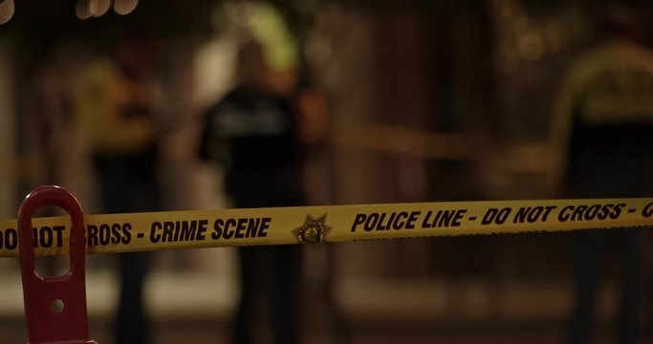
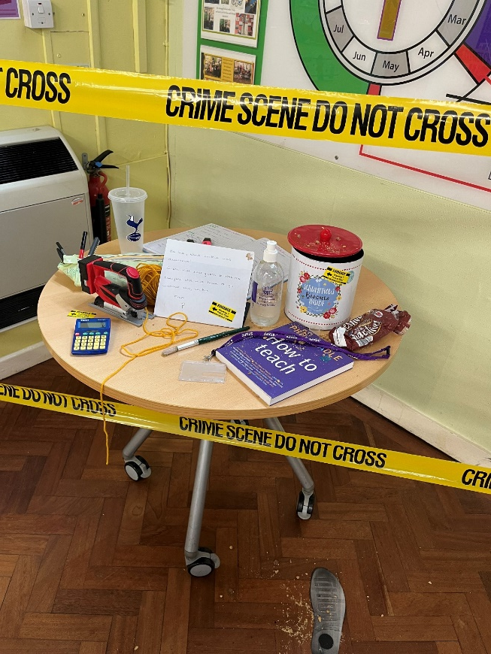
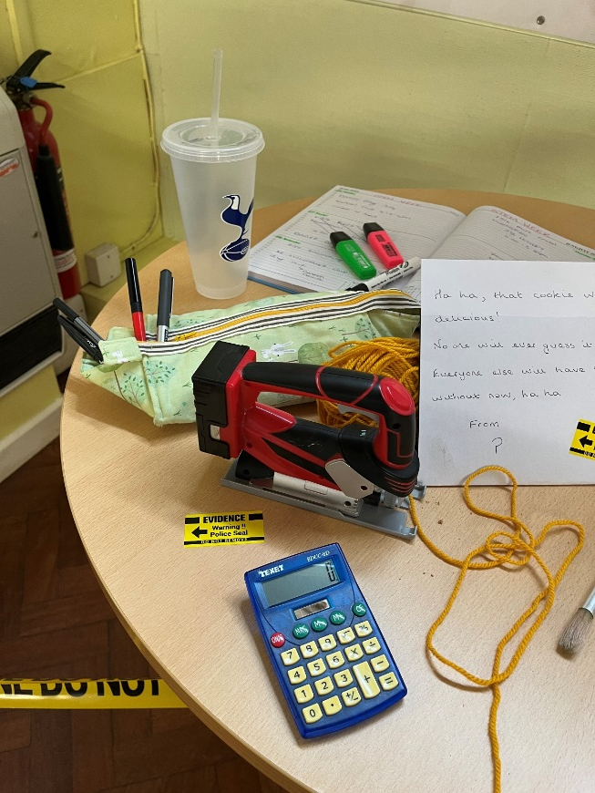
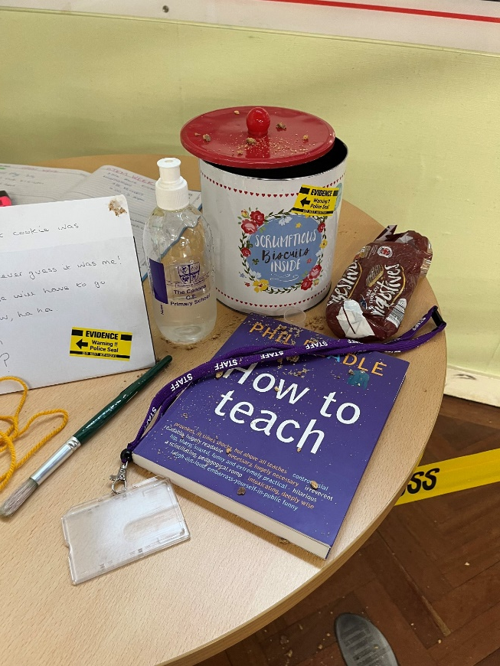
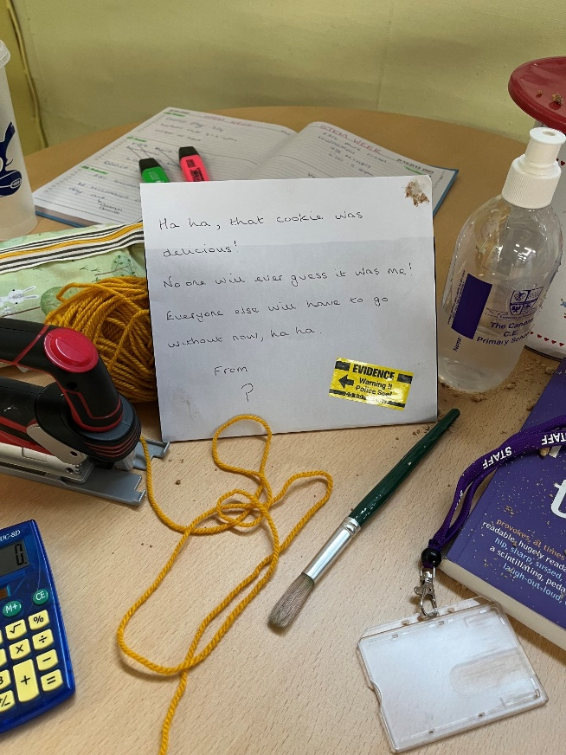
The Crime Scene:
Evidence has been removed from the staff room and placed in the upper school hall for you all to see.
Each year group will be given one piece of evidence that they need to investigate – just like a forensic scientist!

Slide 3

The Suspects:
The following 5 members of staff were in the staffroom at the time of the crime and are potential suspects!
Can you guess who?...

Slide 4
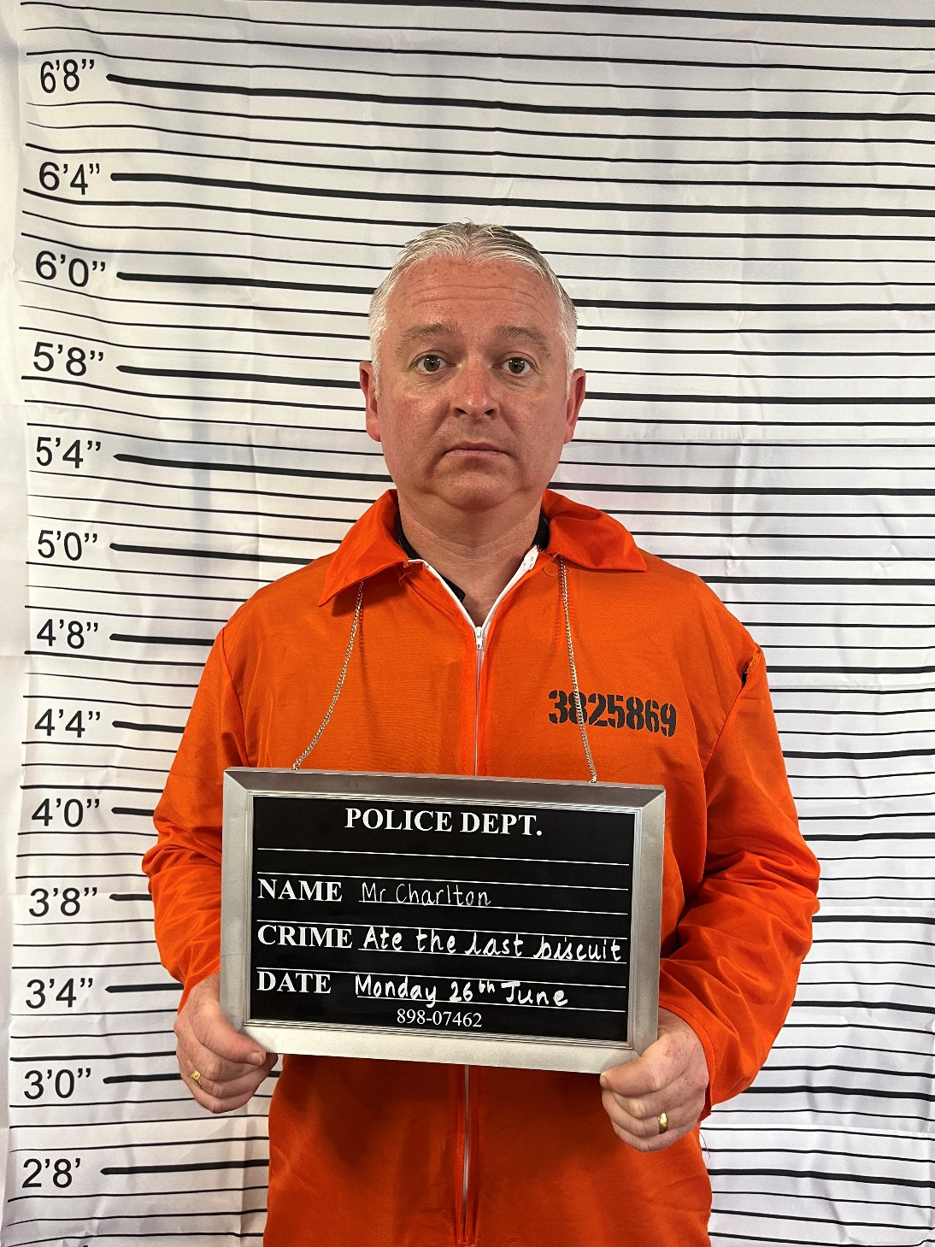
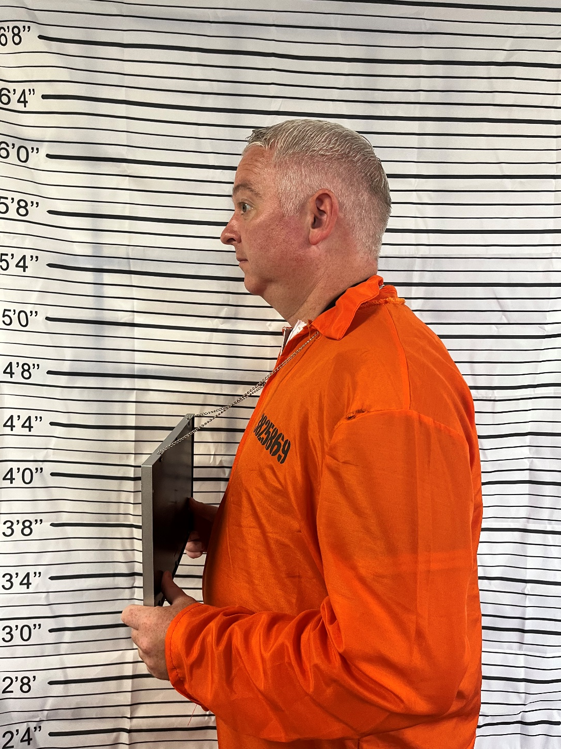
Suspect 1 – Mr Charlton

Slide 5
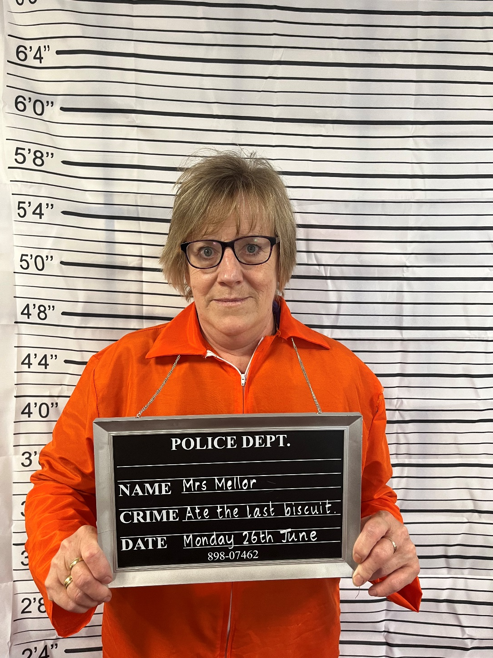
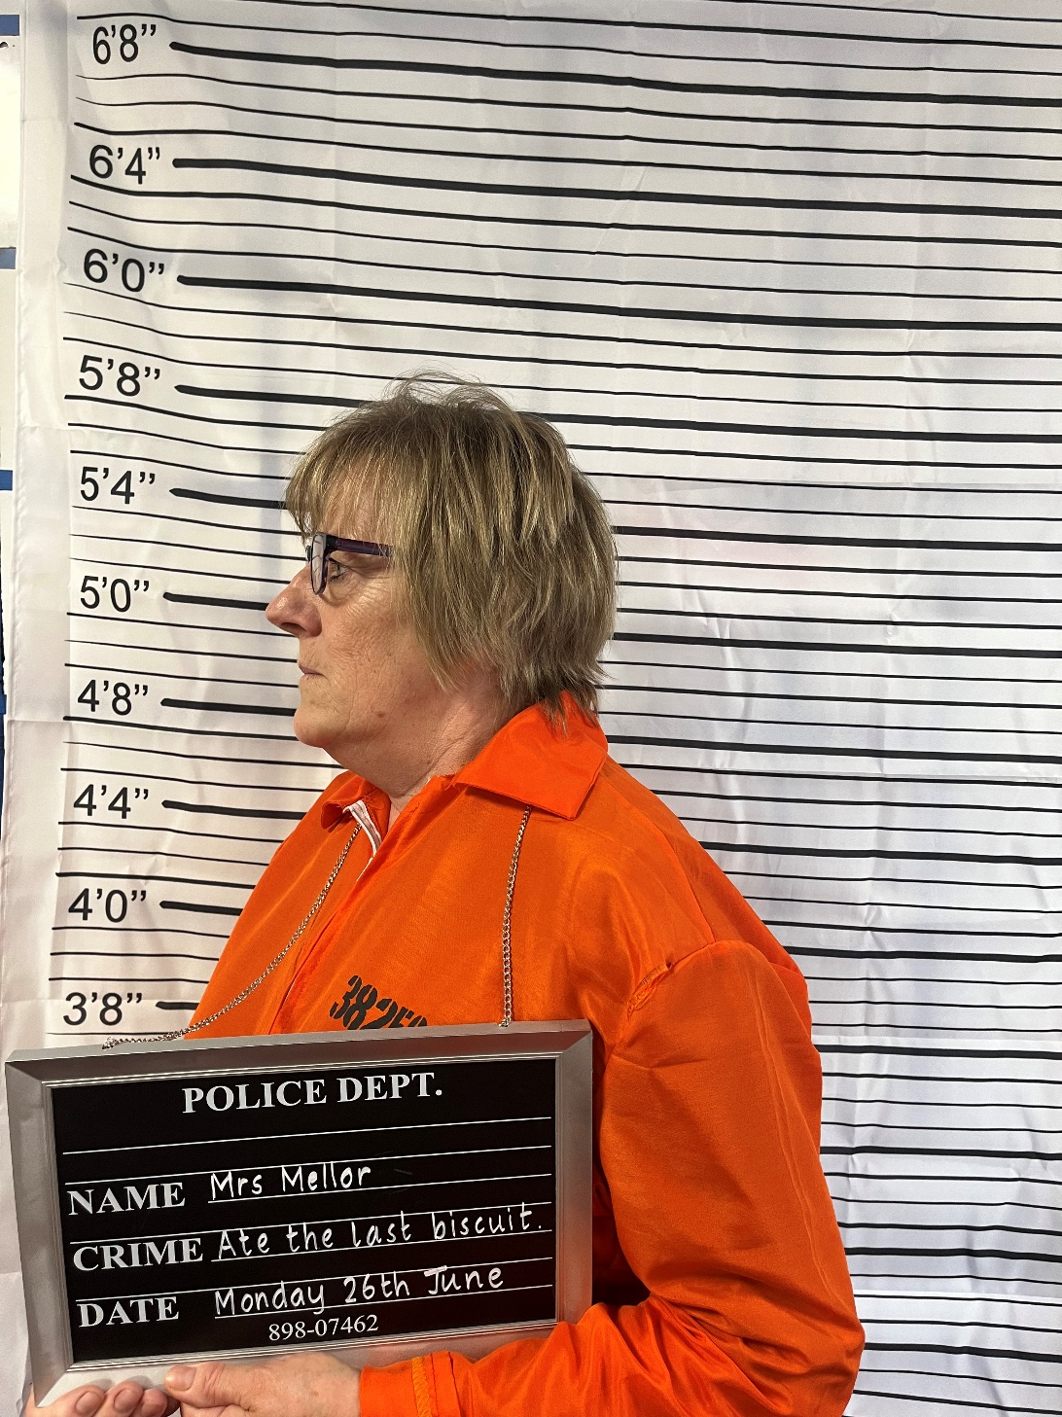
Suspect 2 – Mrs Mellor

Slide 6
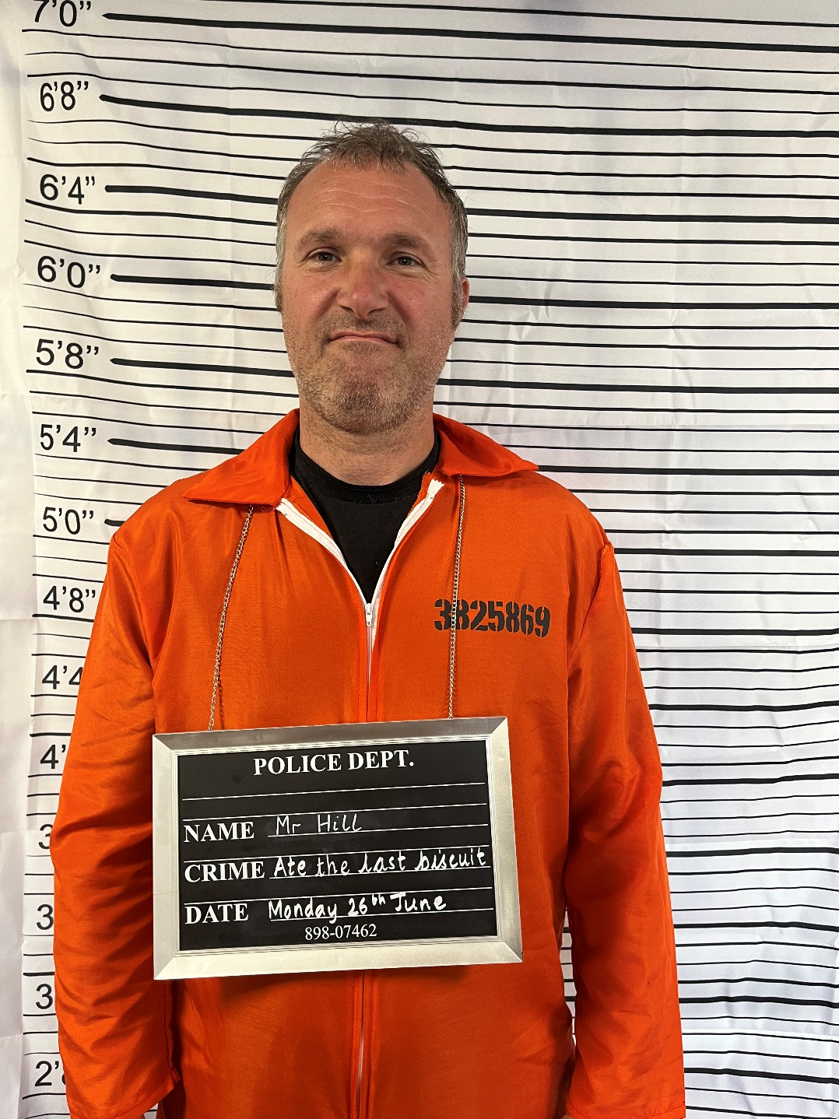
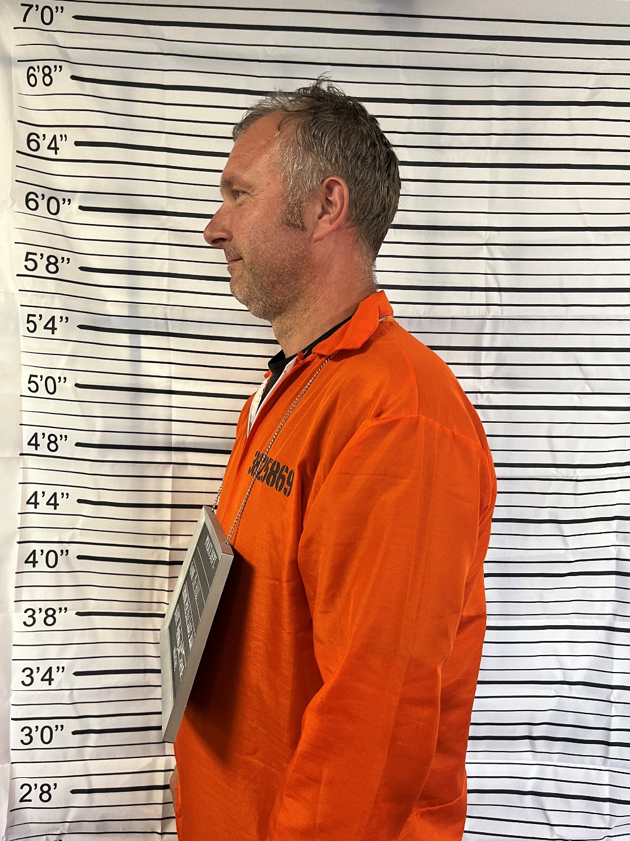
Suspect 3 – Mr Hill

Slide 7
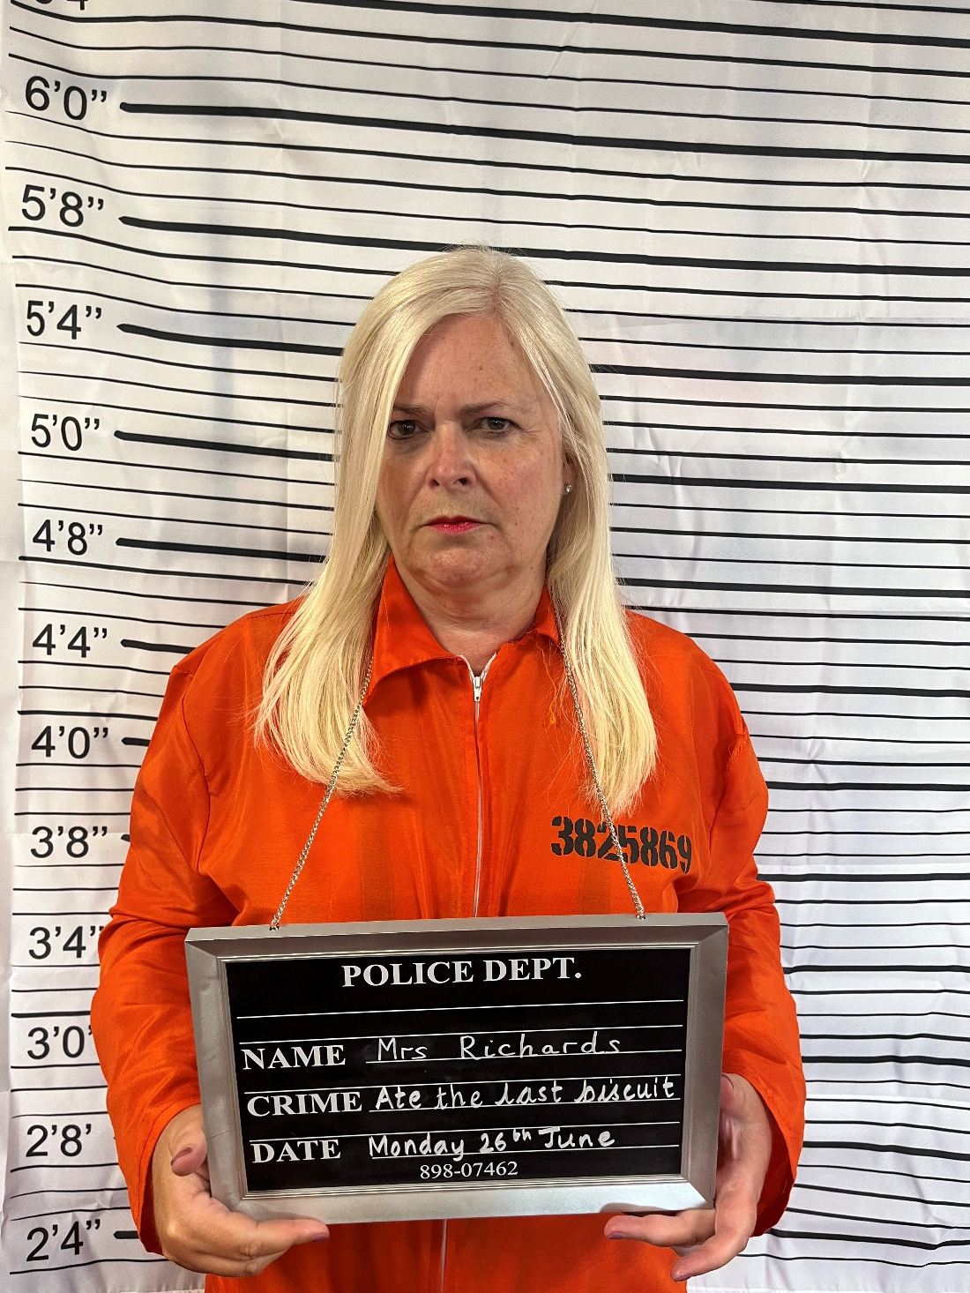
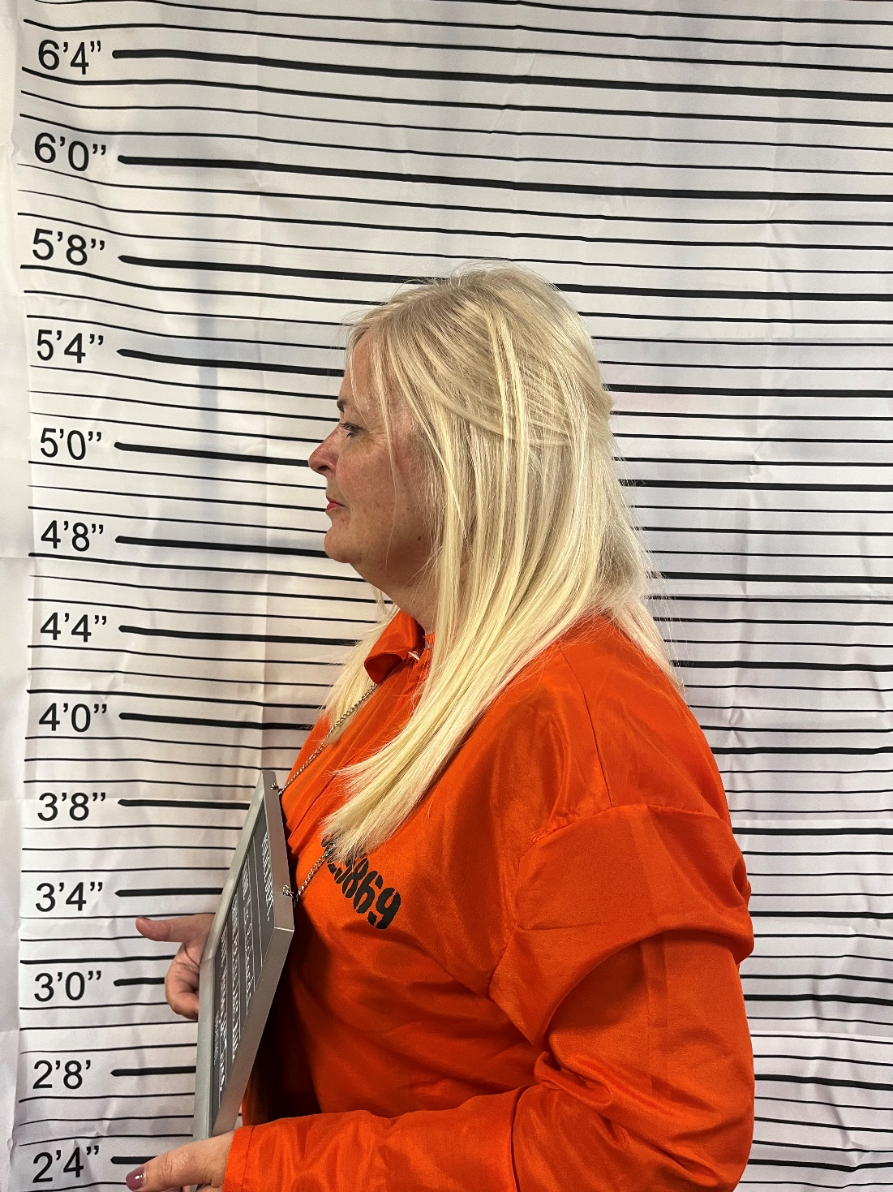
Suspect 4 – Mrs Richards

Slide 8
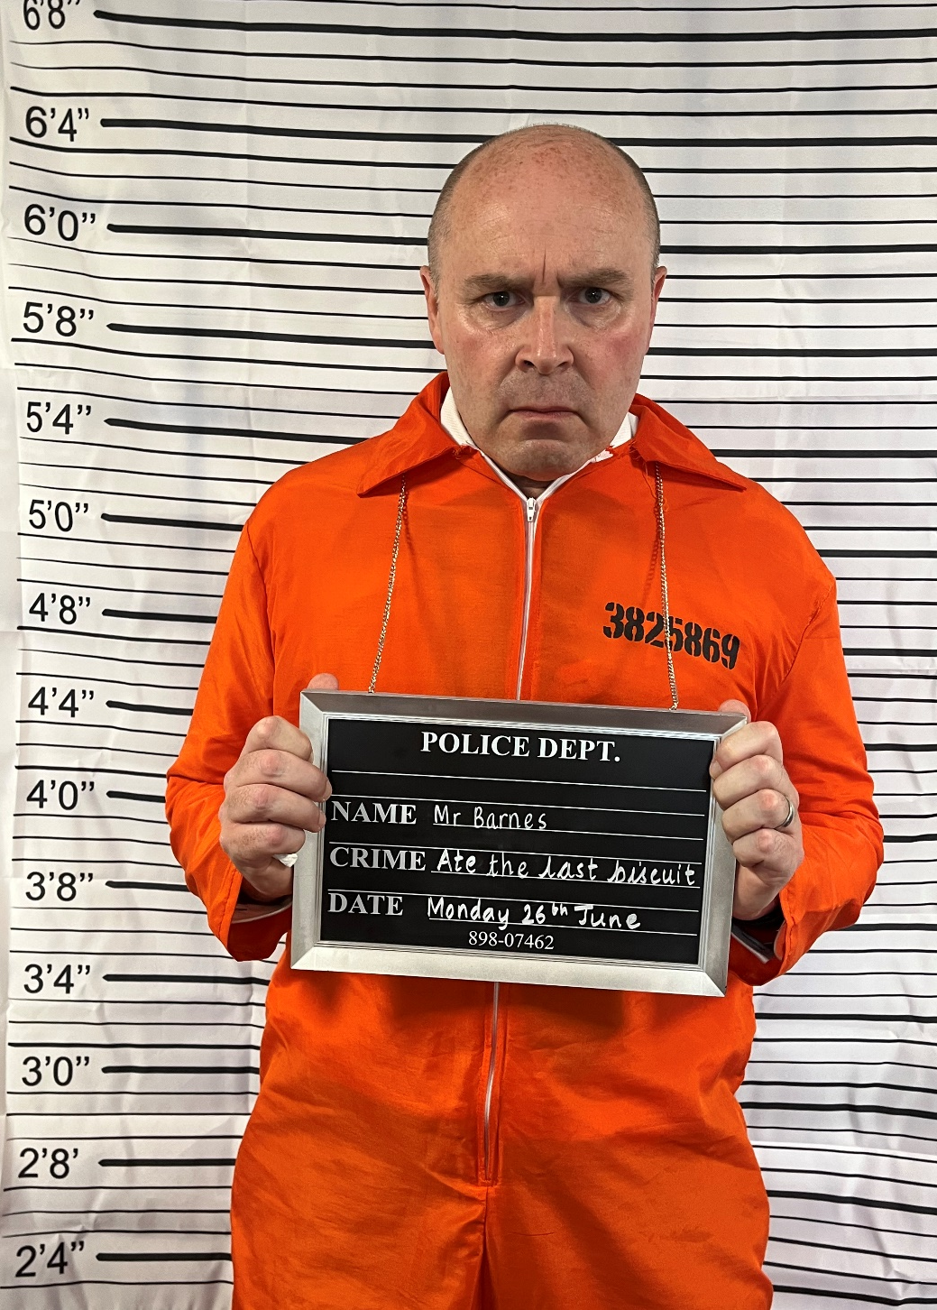
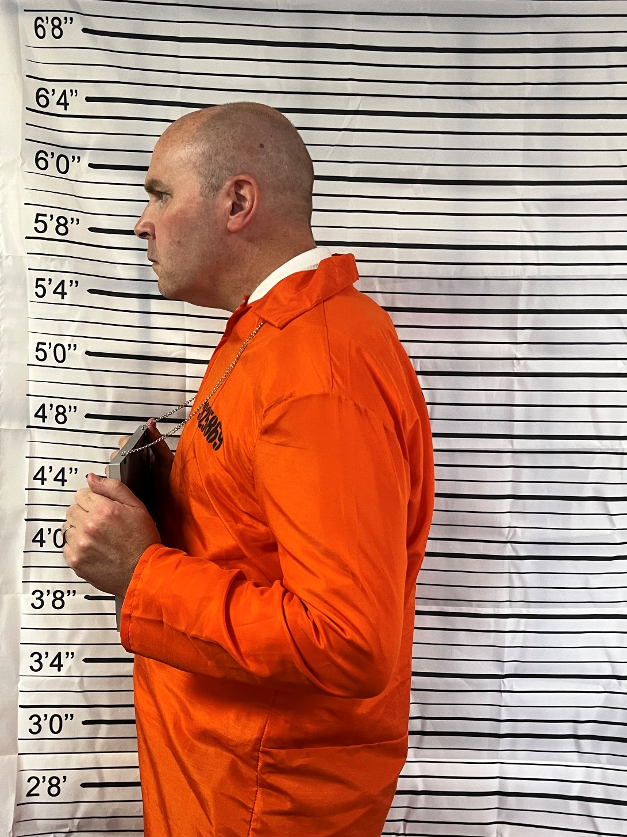
Suspect 5 – Mr Barnes

Slide 9
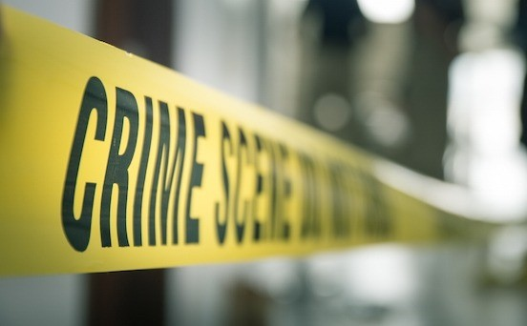

Reception
Look again at the picture of the crime scene, one thing is missing this is a clue to what that member of staff likes to do when they are not at school – Can you work out who had the last cookie?

Slide 10
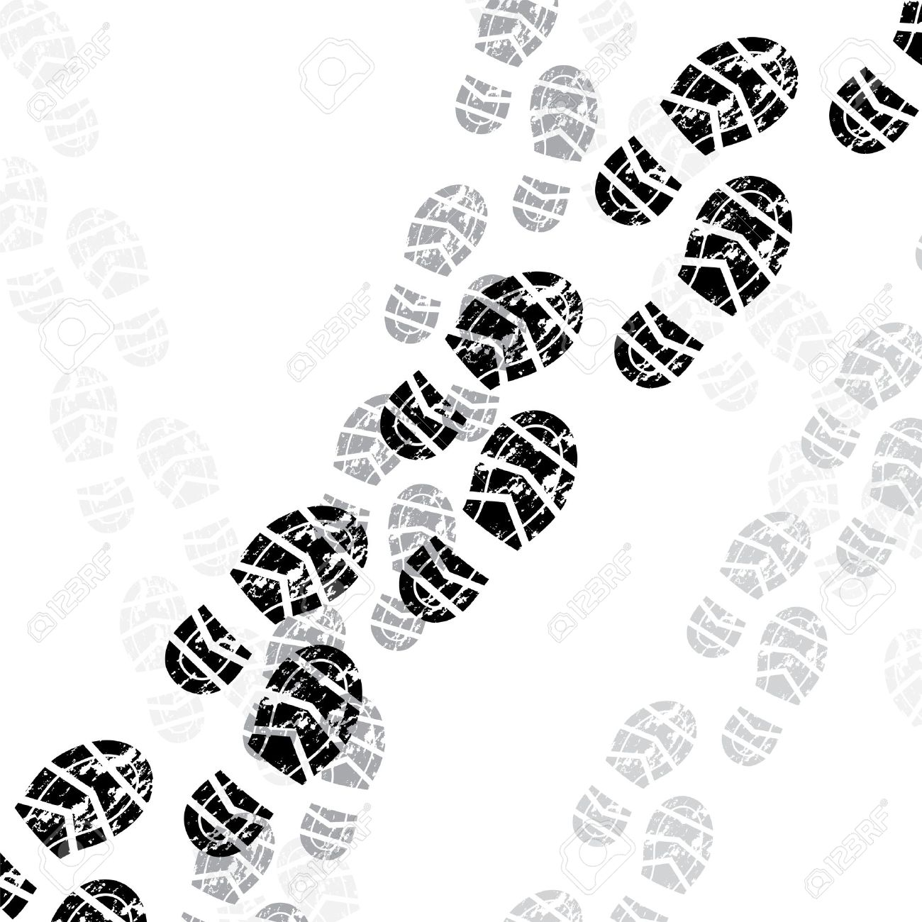
Year 1
You will investigate footprints. You will first compare your own shoeprints in the classroom to find out if they are the same. Then ask suspects for their shoeprints. Can they match any of them to the ones at the crime scene?

Slide 11

Year 2 and
3
You will be taking fingerprints. Are all of our fingerprints the same? Discuss how they are unique. Your class teacher will give you instructions to take fingerprints on the bottle left next to the empty biscuit packet.

Slide 12


Year 4 and Year 5
Can you match a pen to the note from the crime scene? You will get a selection of pens, each one belonging to a different suspect.
You will try out chromatography. Make sure you work methodically to ensure it is a fair test.
Do any of the pens match the clue in the crime scene?
Chromatography is a technique used to separate soluble substances that have been mixed together. It’s normally used to separate coloured mixtures, like food colourings.

Slide 13
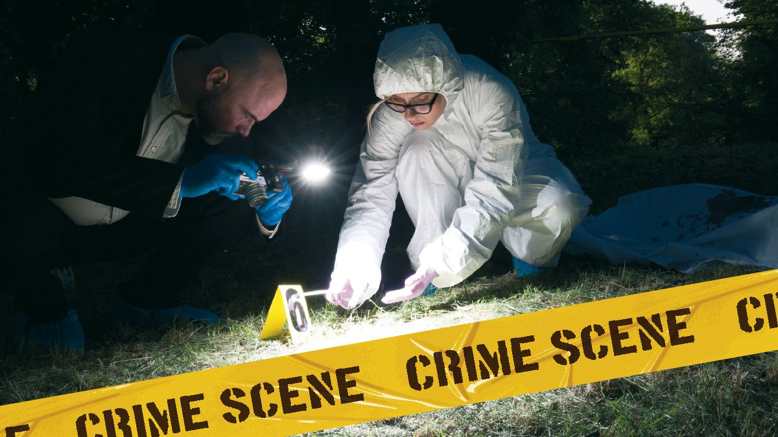
Year 6
You should already know that humans are all different and that we carry characteristics from our parents. We all have DNA – in fact, all living things have DNA – and that it can be used to help to solve crimes.
Scientists can extract DNA from all sorts of evidence, including hairs, fibres, etc. It requires specialist equipment to do this, but we can extract a DNA strand from a strawberry and this is what you will be doing.

Slide 14
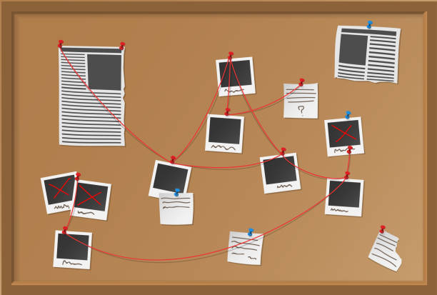
Finding the culprit
Each year group will need to display their evidence on the crime scene board that will be displayed in the upper school hall. On Friday after school you will be able to take your grown-ups to our STEM week exhibition and look at all the evidence each year group has gathered to see if you all found the same suspect guilty.
Will you solve the crime?

