Slide 1


Welcome
to
Year 4

Slide 2
Firstly, the children have settled really well into their new year group, we wanted to provide an opportunity to discuss expectations in upper school and any changes.
It will also be an opportunity to ask questions about the upcoming year!

Slide 3
Today’s meeting…
We want to provide an opportunity to:
discuss expectations in school
explain the Year 4 curriculum
discuss any changes
Answer any questions you may have

Slide 4
Behaviour and expectations:
Vision: Live life in all its fullness
Core values: Respect, Believe, Achieve
Golden rules:
Respect for people
Respect for property

Slide 5
Dojo – Class teacher communication
We still use class dojo in upper school.
This is the best way to contact the class teacher if you need to pass on a message, discuss a worry or arrange to see us.
Dojo points are sent home to show when your child has done something well and we may send more personal messages too.
You may still call the office if you need to – especially if there is a change to collection arrangements as we may not see it in time.
(Arrangements after 2:45pm – office only)

Slide 6
Morning Routine
In the morning, children come on to the grounds from 8:30 via gate 4. Children should be in school by 8:45am.
They will then complete their morning jobs.
Registration closes by 8.55 every day.

Slide 7
What does my child need?
Children are expected to wear full school uniform.
Winter uniform – Grey trousers/skirt, white shirt, school tie, cardigan/jumper with house colour badge. Grey/white socks with plain black footwear.
Summer Uniform: Grey shorts, purple gingham summer dresses, plain white polo shirt (no tie). Same rules regarding footwear.
PE Kit: House colour t-shirt, dark coloured shorts and pumps/trainers (You will be informed of when outdoor PE will take place for your child) They will need a dark coloured tracksuit for these lessons (they can leave them in lockers)
Water bottles: School water bottles can be purchased from the school office for £1. Please name them clearly.
Lunch boxes : If your child is packed lunch, please name their belongings clearly.
School bags: Children can have a backpack if they wish.
Pencil cases: Children can, if they like, have a pencil case, however, we do supply them with all stationery. There is no expectation for this.
Snack: Breaktime snacks should be a healthy option please.

Slide 8
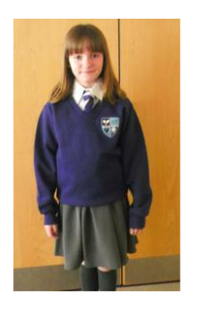
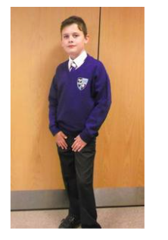

Slide 9
Lunches
School dinners are currently priced at approximately £2.75
The children have four choices every day: red (meat), green (vegetarian),brown (jacket potato) or a pasta dish (yellow) This is the same menu as lower school.
The same payment system is used as in lower school (when paying for trips etc.)
Some children are FSM – Please check with the office

Slide 10
Medication and permissions
Please ensure any medication is in school.
It is really important that all items are ‘In date’ and clearly labelled.
Contact details
Sometimes parents/carers change telephone numbers, emails etc. Please update all information as soon as possible. There is a new app for this- please see the office for further information.
Pictures – dojo/website/media
We use pictures a lot. Please double check that we have up to date information regarding permission for this/or not. The school office will be happy to help ☺

Slide 11

Year 4 Curriculum….
Autumn – Protecting our world
Spring – The Celts and The Romans
Summer – The Anglo-Saxons and The Vikings
In addition to these topics, we also learn about a variety of science topics- including states of matter, light and sound, teeth and digestion, electricity, climates and biomes.
Trips and Visitors…
Autumn- Severn Trent workshops
Spring- Lunt Roman Fort (booked)
Summer- Portals to the Past – Vikings (TBC)
Link for PANTO has been sent via Dojo
We will send information about the above nearer the time.

Slide 12
Reading
‘Tracker’ book (fruit book/colour band/phonics book): This book is the book that they will read to an adult in school and should always take priority. This book will be an appropriate book for their reading ability. They will be monitored and assessed every half term.
We ask that children read 3 times a week at home and have their diaries signed. Children can change this book daily.
Reading for pleasure book: Children can choose any book that they like from a class bookshelf or the library.
We are happy for children to read any book they are interested in at home. This can count as one of their reads.

Slide 13
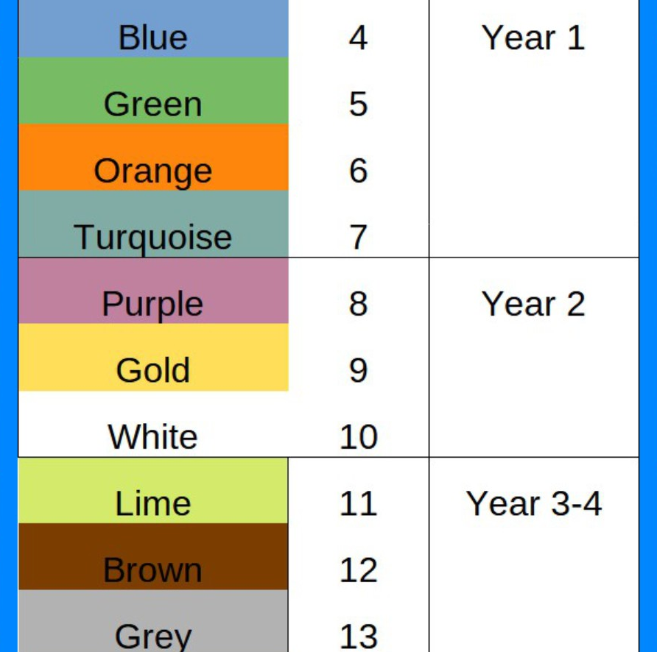
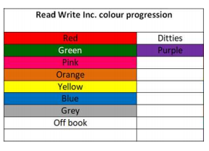
Tracker books
Fruits- Accelerated reader banded books
Strawberry
Banana
Apple
Grape
Pineapple

Slide 14


Slide 15
Writing
To be writing at the expected standard in Year 4, children should be able to:
Spell the Year 4 common exception words and use them in writing
Apply the Year 4 spelling rules
Write in sentences that are coherent
Use paragraphs
Write for different purposes
Use a range of punctuation () ! ? , . : “”
Use past and present tense accurately
Use a range of descriptive techniques

Slide 16
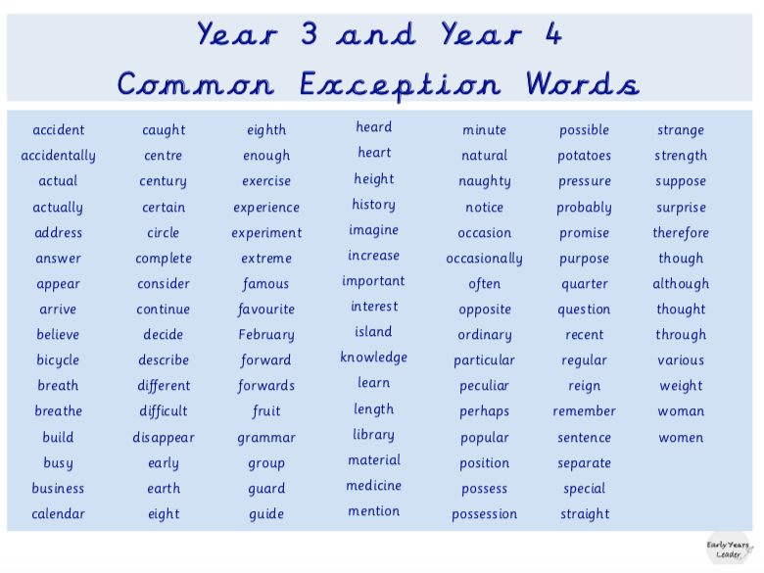
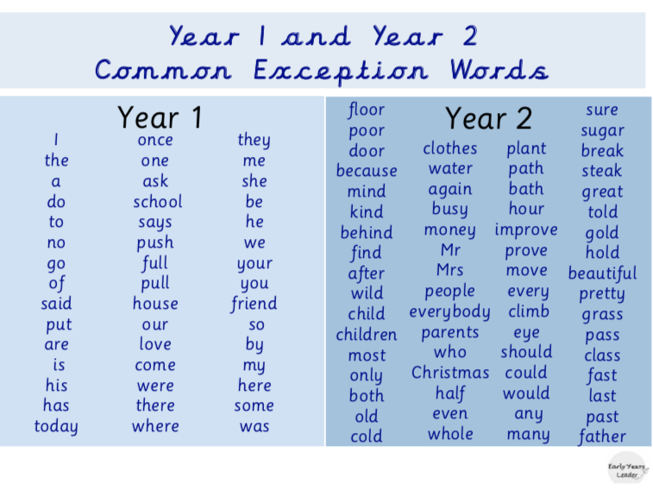
Common Exception words

Slide 17
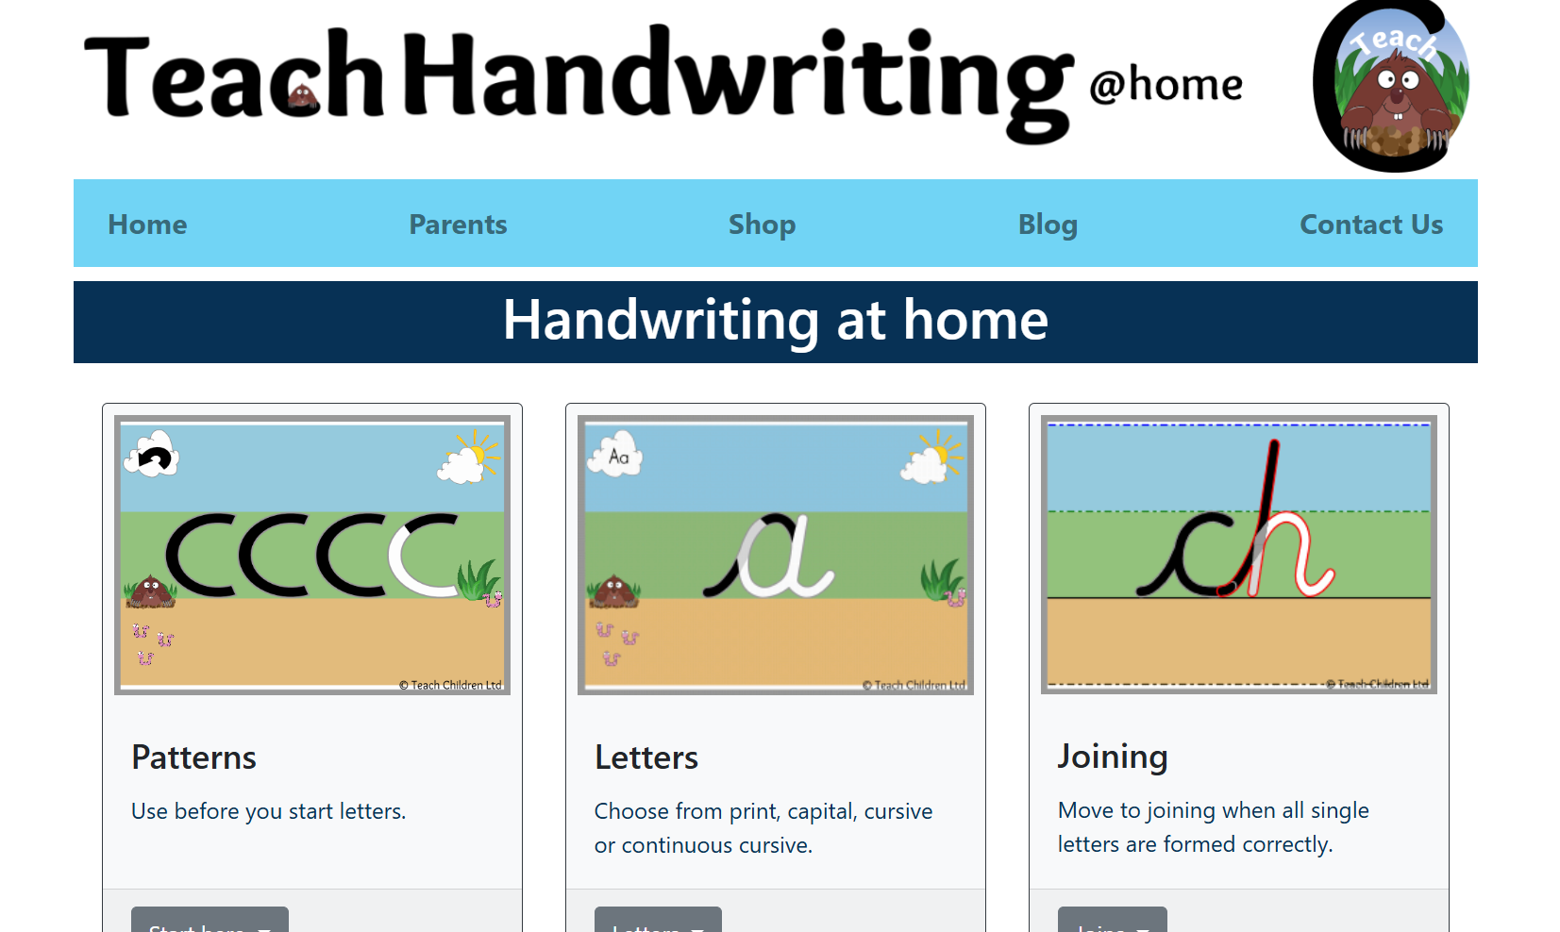
Handwriting
Children are expected to learn to join their handwriting in a neat, cursive style in Year 4. We are working hard on this!
Writing should sit on the line, have finger spaces and ascender and descender letters should be of an appropriate and consistent size.
Children will be provided with a handwriting pen when they can show neat, cursive writing with their pencil.
Teach Handwriting website:
https://teachhandwriting.co.uk/

Slide 18
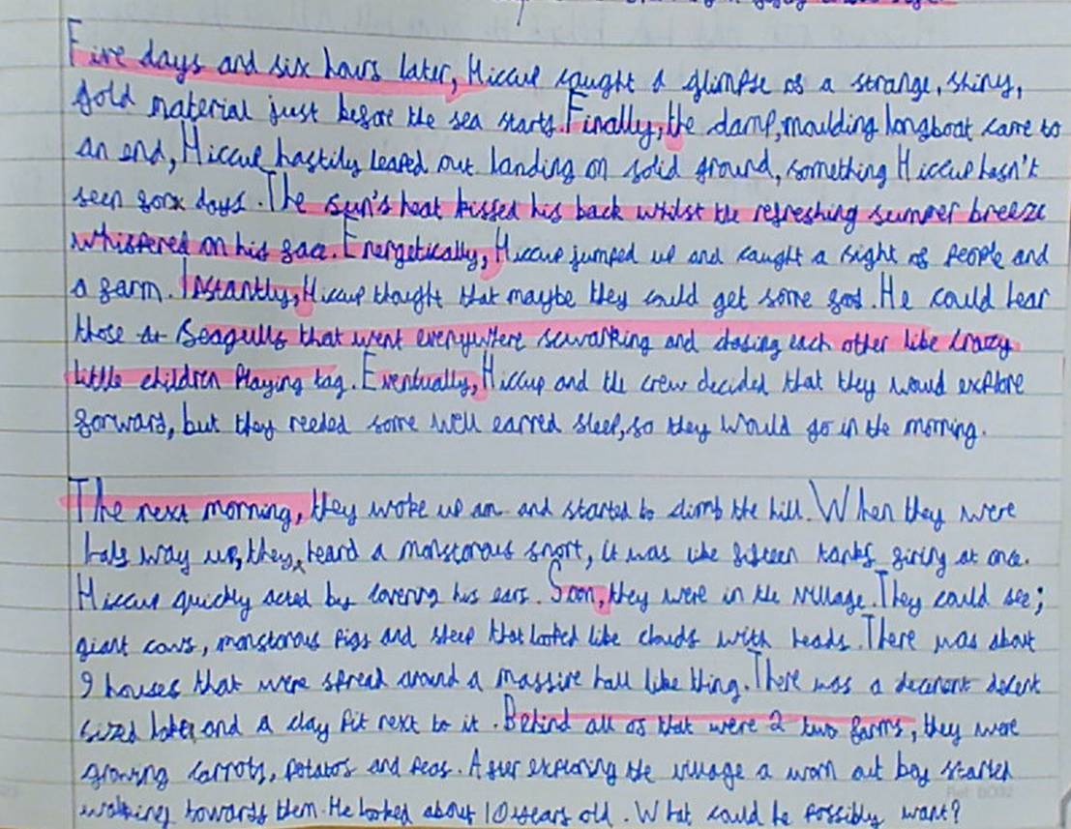
Writing example

Slide 19
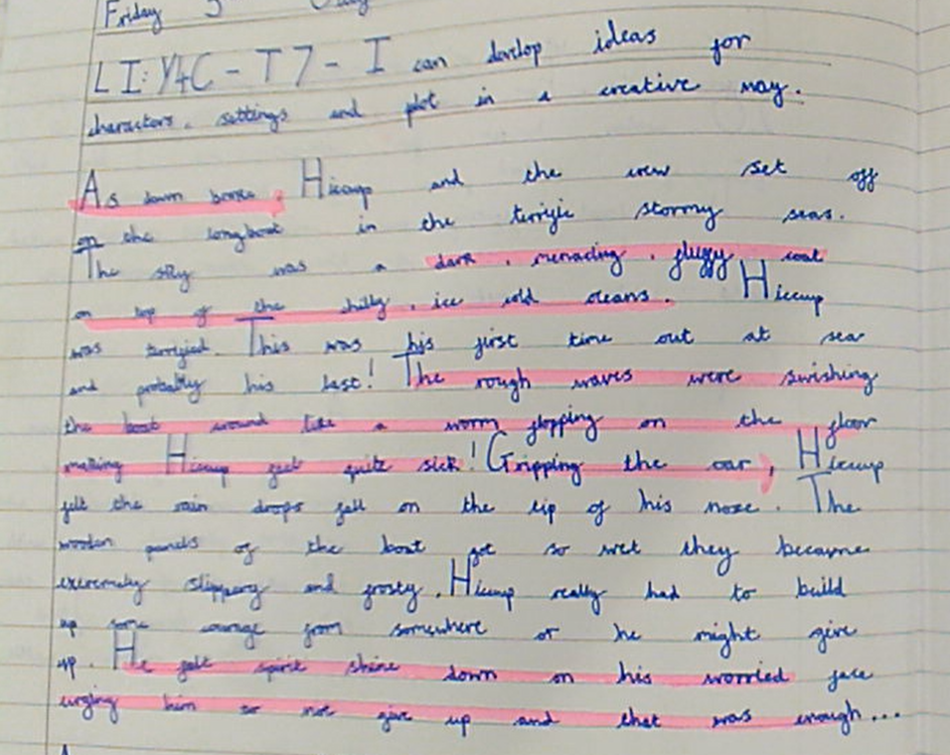
Writing example

Slide 20
Maths
We primarily follow the White Rose scheme for Maths supplemented by other schemes which works with a small step approach for each new concept. All children are expected to show mastery in lessons where they explain how and why they know something.
Children need to learn number facts as instant recall and show fluency by applying their knowledge in different contexts. We prepare for the National Times Tables test in Year 4.
In Year 4, children should instantly know:
Addition and subtraction facts (from year 1, 2 and 3)
Times tables and division facts for the 1-12 times tables.
Fluency, rapid recall and automaticity is an integral part of the KS2 curriculum- to allow the working memory to apply skill and solve problems.

Slide 21
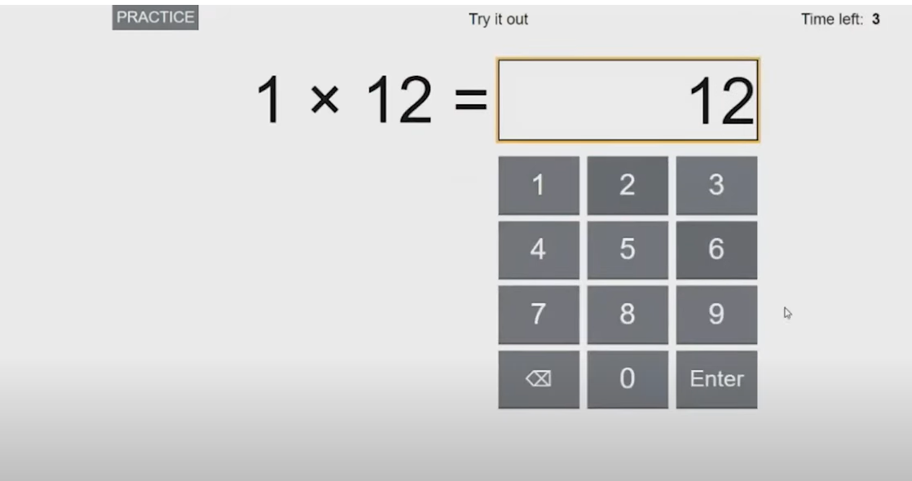
What is the multiplication tables check 2026?
It is an on-screen check consisting of 25 times table questions. Your child will be able to answer 3 practice questions before taking the actual check. They will then have 6 seconds to answer each question. On average, the check should take no longer than 5 minutes to complete.
This online platform will be a great to to use practise with the timings and the layout of the test itself.
Multiplication Tables Check - 2025 - Timestables.co.uk
https://www.timestables.co.uk/multiplication-tables-check/

Slide 22
The purpose of the check is to assess the fluency and accuracy of fact recall, which is essential for future success in mathematics. It will also help your child’s school to identify if your child may need additional support.
Fluency is viewed as an essential part of the new maths curriculum, if a child is fluent and autonomous with maths facts then it enables them to use working memory for problem solving and applying their knowledge to skills.

Slide 23
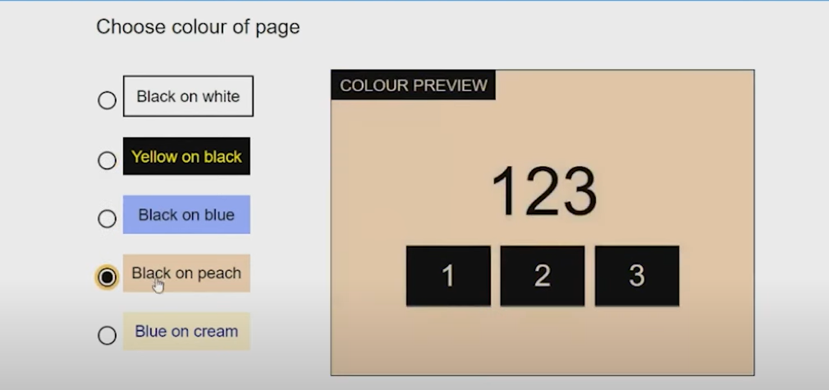
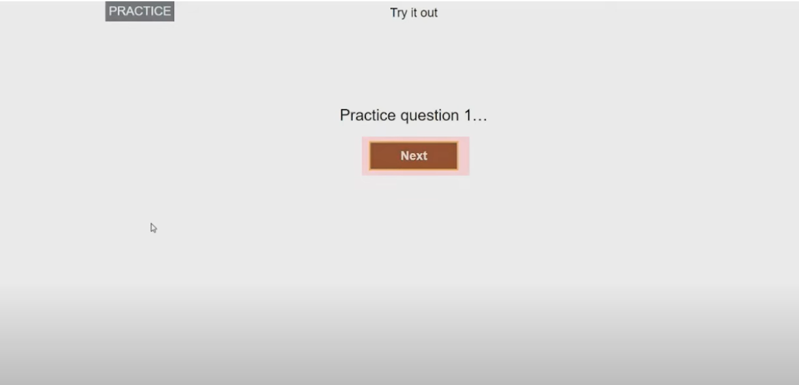
Access arrangements
There are some small arrangements that an be made for some children that need adaptations.
Such as;
- Screen colour changes- (visual/learning needs)
Introduce ‘Next’ button
Remove on screen number pad- input using keyboard
Input assistance from an adult

Slide 24
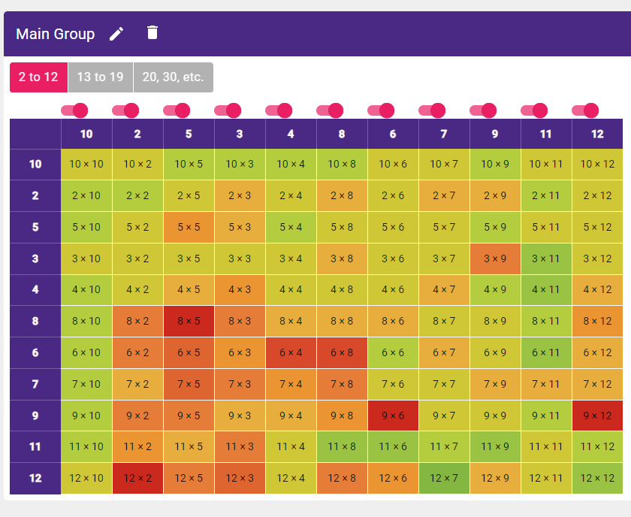
Useful links for times table practise
TT Rockstars
Multiplication Tables Check - 2025 - Timestables.co.uk
Times Tables Games for 7 to 11 year olds (topmarks.co.uk)
‘Little and often’ is best approach to learning and consolidating factual knowledge.
This will be discussed at
parents evening.

Slide 25
Homework
Homework will be sent soon. We will be using workbooks for this.
Homework will be set on a Friday.
Returned for the following Thursday please.
All homework will relate to prior or current learning.
We offer a homework facility every Tuesday. This will run from 3:15pm – 4:00pm. Please note that this is independent time to complete homework.
This can be booked via Dojo - Collection from Gate 3.

Slide 26
How you can help at home…
Support with homework
Read with and to your child
Practise their spellings
Practise their times tables (TT Rockstars 10 mins a day)
Prepare them with PE kit etc
Be on time to school
Let us know if they or you need support

