Slide 1

Welcome
to
Year 3

Slide 2
Today’s meeting…
We want to provide an opportunity to:
Discuss expectations in Upper School
Explain the Year 3 curriculum
Discuss any changes
Answer any questions you may have

Slide 3
Behaviour and expectations:
Motto: Live life in all its fullness
Core values: Respect, Believe, Achieve
Golden rules:
Respect for people
Respect for property

Slide 4
Communication
We still use class dojo in upper school.
This is the best way to contact the class teacher if you need to pass on a message, discuss a worry or arrange to see us.
Dojo points are sent home to show when your child has done something well and we may send more personal messages too.
You may still call the office if you need to – especially if there is a change to collection arrangements as we may not see it in time.

Slide 5
Morning Routine
In the morning, children come on to the grounds from 8:30 via gate 4.
Children should be in school by 8:45am.
They will then complete their morning jobs.
Registration closes by 8.55 every day.

Slide 6
Uniform
Children are expected to wear full school uniform.
Winter uniform – Grey trousers/skirt, white shirt, school tie, cardigan/jumper with house colour badge. Grey/white socks with plain black footwear.
Summer Uniform: Grey shorts, purple gingham summer dresses, plain white polo shirt (no tie). Same rules regarding footwear.
PE Kit: House colour t-shirt, dark coloured shorts and pumps/trainers (You will be informed of when outdoor PE will take place for your child) They will need a dark coloured tracksuit for these lessons (they can leave them in lockers)

Slide 7
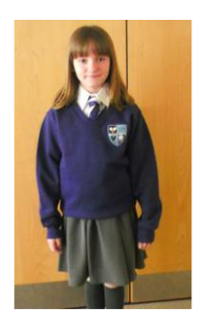
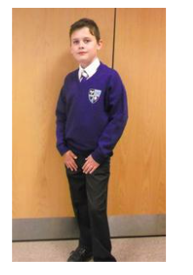

Slide 8
What else do they need?
Water bottles: School water bottles can be purchased from the school office for £1. Please name them clearly. Only Canons water bottles are allowed in the classroom so all children should have one.
Lunch boxes: If your child is packed lunch, please name their belongings clearly.
Healthy snack: Children are allowed to bring in a healthy snack for break times. Everyone is offered half of a bagel at break times.
School bags: Children can have a backpack if they wish.
Pencil cases: Children can, if they like, have a pencil case, however, we do supply them with all stationery. There is no expectation for this.

Slide 9
Lunches
School dinners are currently priced at approximately £2.75 per day.
The children have four choices every day: red (meat), green (vegetarian), brown (jacket potato) or yellow (pasta). This is the same menu as lower school.
The same payment system is used as in lower school (when paying for trips etc.)
Pupil Premium children receive a free school meal.

Slide 10
The Year 3 Curriculum
Autumn – South America
(inc. Amazon rainforest)
Spring – The Stone Age
Summer - The Ancient Greeks
In addition to these topics, we also learn about a variety of science topics- Including Plants and Living Things, Light, Magnets and Forces

Slide 11
Reading
‘T``racker’ book (colour band/phonics book): This book is the book that they will read to an adult in school and at home and should always take priority. This book will be an appropriate book for their reading ability. They will be monitored and assessed every half term.
We ask that children read 3 times a week at home and have their diaries signed. Children can change this book daily.
Reading for pleasure book: Children can choose any book that they like from a class bookshelf or the library.
We are happy for children to read any book they are interested in at home. This can count as one of their reads.

Slide 12
Writing
To be writing at the expected standard in Year 3, children should be able to:
Spell the Year 3 common exception words and use them in writing
Apply the Year 3 spelling rules
Write in sentences that are coherent
Use paragraphs
Write for different purposes
Use a range of punctuation () ! ? , . : “”
Use past and present tense

Slide 13
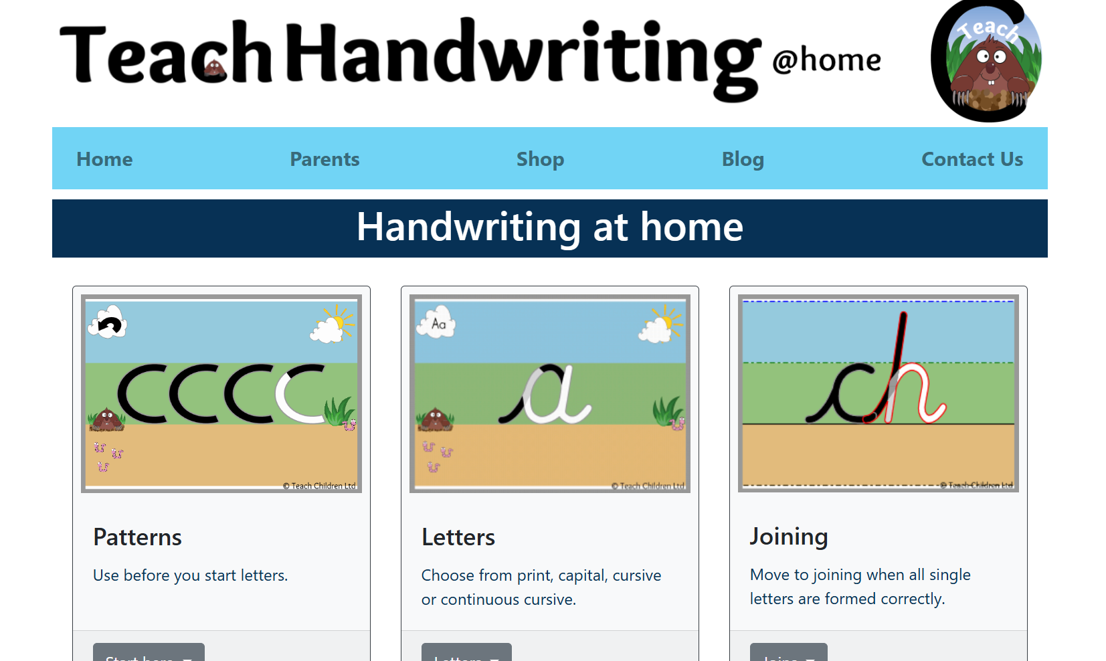
Handwriting
Children are expected to learn to join their handwriting in a neat, cursive style in Year 3. We are working hard on this!
Writing should sit on the line, have finger spaces and ascender and descender letters should be of an appropriate size.
Children will be provided with a handwriting pen when they can show neat, cursive writing with their pencil.
We use the Teach Handwriting website:
https://teachhandwriting.co.uk/

Slide 14
Maths
We follow the White Rose scheme for Maths which works with a small step approach for each part of learning. All children are expected to show mastery in lessons where they explain how and why they know something.
Children need to learn number facts as instant recall and show fluency by applying their knowledge in different contexts. We prepare for the National Times Tables test in Year 4.
In Year 3, children should instantly know:
Addition and subtraction facts (from year 1 and 2)
Times tables and division facts for the 10x 2x 5x 3x 4x and 8x tables

Slide 15

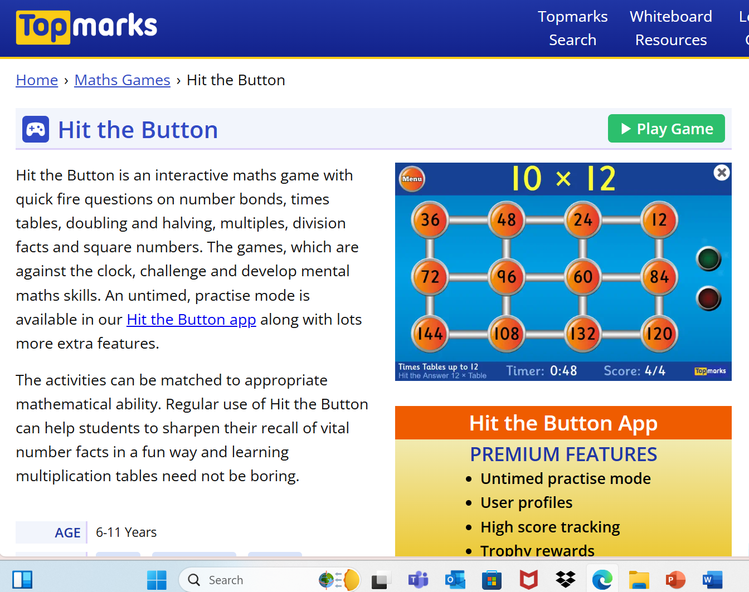
Helpful websites
https://www.topmarks.co.uk/english-games/7-11-years/spelling-and-grammar
https://www.topmarks.co.uk/maths-games/hit-the-button
https://ttrockstars.com/ Children will be given a times table rockstar log in

Slide 16
Homework
It is set on Thursday.
Returned for the following Thursday.
Homework will be set on Seesaw.
All homework will relate to prior or current learning.
We offer a homework club facility every Thursday. This will run from 3:15pm – 4:00pm. Please note that this is independent time to complete homework children will not receive 1:1 support to complete in this time. Collection is from Gate 3.

Slide 17
Medication and permissions
Please ensure any medication is in school.
It is really important that all items are ‘In date’ and clearly labelled.
Contact details
Sometimes parents/carers change telephone numbers, emails etc. Please update all information as soon as possible.
Pictures – dojo/website/media
We use pictures a lot. Please double check that we have up to date information regarding permission for this/or not. The school office will be happy to help ☺

Slide 18
Upcoming trip…
Birmingham’s Botanical Gardens!
To end our ‘South America’ topic, we will be travelling to the botanical gardens for a day of rainforest fun with an animal workshop too.
We will be sending a letter this week with more details!

Slide 19
Performance…
The children in upper school perform at different times in the year.
Year 3 perform for their parents at Christmas time. Dates will be available closer to the time.

Slide 20
How you can help at home…
Support with homework
Read with and to your child
Practise their spellings
Practise their times tables
Prepare them with PE kit etc
Be on time to school
Let us know if they or you need support

Slide 21
Thank you for coming!
Feel free to take a look at the year 3 area and classrooms before you go.

