Slide 1

Welcome to Year 1
Notes:
Introduce ourselves

Slide 2
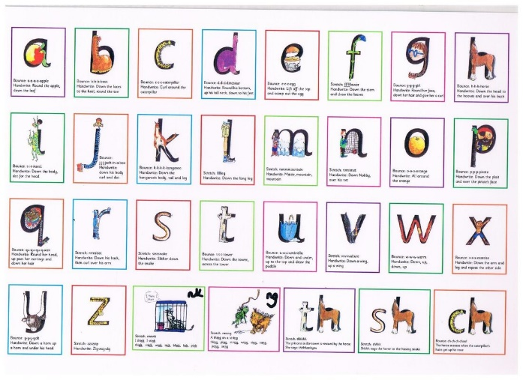
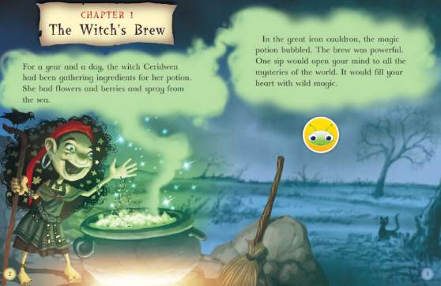
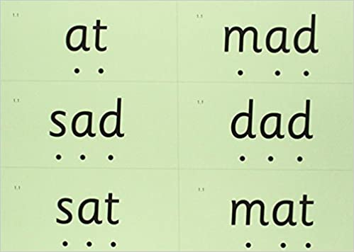
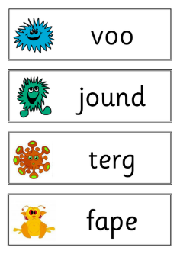


How do children learn to read at The Canons?
Phonics sounds and red words
Blending the sounds to make green words and alien words
Reading texts fluently and understanding what they are reading
Notes:
Jen

Slide 3
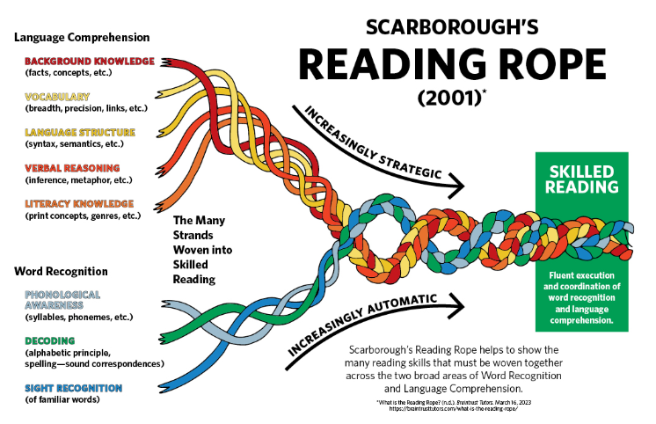
A good reader looks like this:
Notes:
Jen

Slide 4

Where does it start?
Notes:
Jen

Slide 5
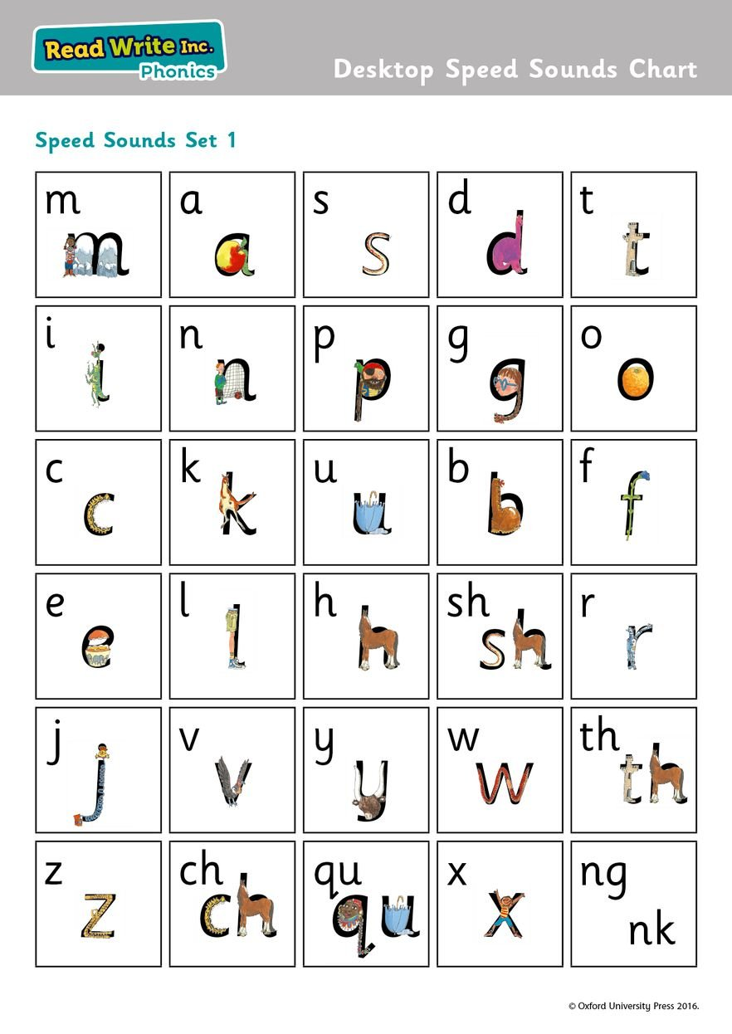
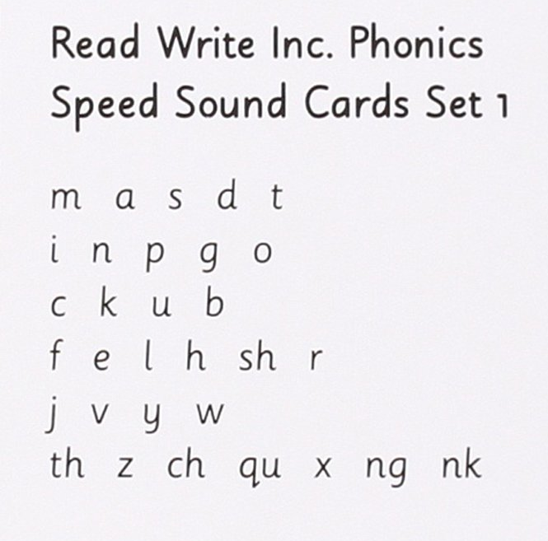
Set 1 sounds
Notes:
Jen

Slide 6
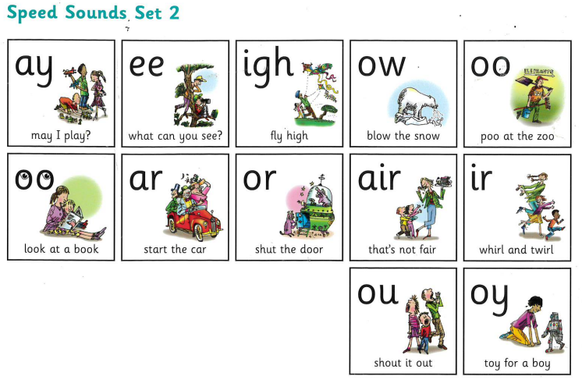
Set 2 sounds
Notes:
Jen

Slide 7
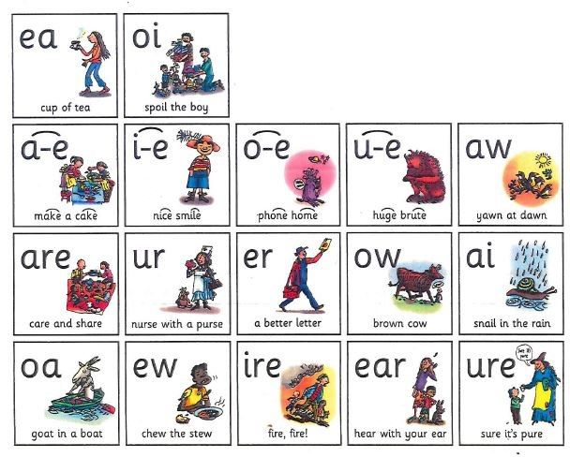
Set 3 sounds
Notes:
Jen

Slide 8
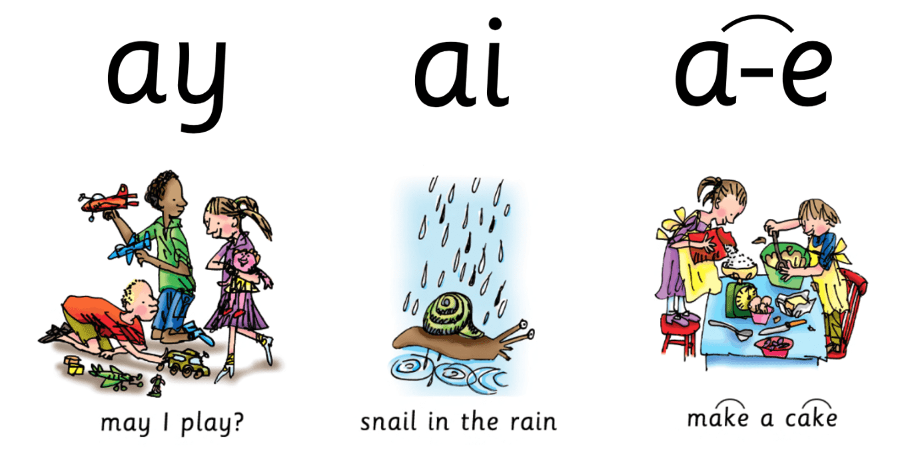
What do we mean by ‘special friends’?
‘Special friends’ are 2 or 3 letters that make one sound.
p r ay t r ai n sh a k e
Notes:
Jen

Slide 9
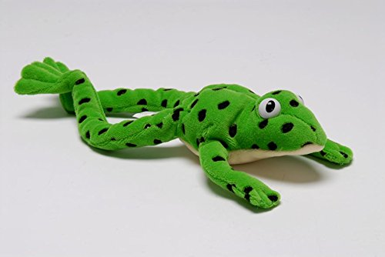
Who is Fred?
Fred can only speak through ‘Fred Talk’ which is blending sounds together to read a word:
p l ay s t r ee t
If your child finds reading tricky, encourage them to ‘Fred Talk’ words to help them read it.
Notes:
Jen

Slide 10
What is the phonics screening check?
Children in Year 1 throughout the country will all be taking part in a phonics screening check during June.
The phonics screening check is designed to confirm whether individual children have learnt sufficient phonic decoding and blending skills to an appropriate standard.
Monday 8th June 2026
Notes:
Jen

Slide 11
Pseudo Words (Nonsense Words)
Pseudo words will be shown to your child with a picture of an alien. This provides the children with a context for the pseudo word which is independent from any existing vocabulary they may have.
Pseudo words are included because they will be new to all pupils; they do not favour children with a good vocabulary knowledge or visual memory of words.
Notes:
Jen

Slide 12
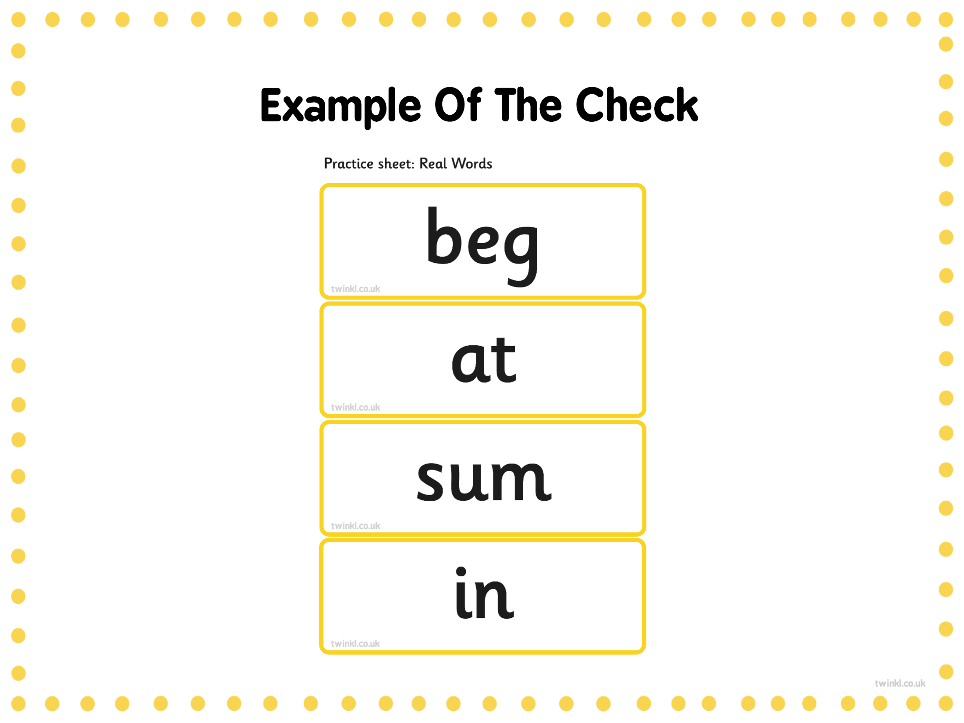
Notes:
Jen

Slide 13
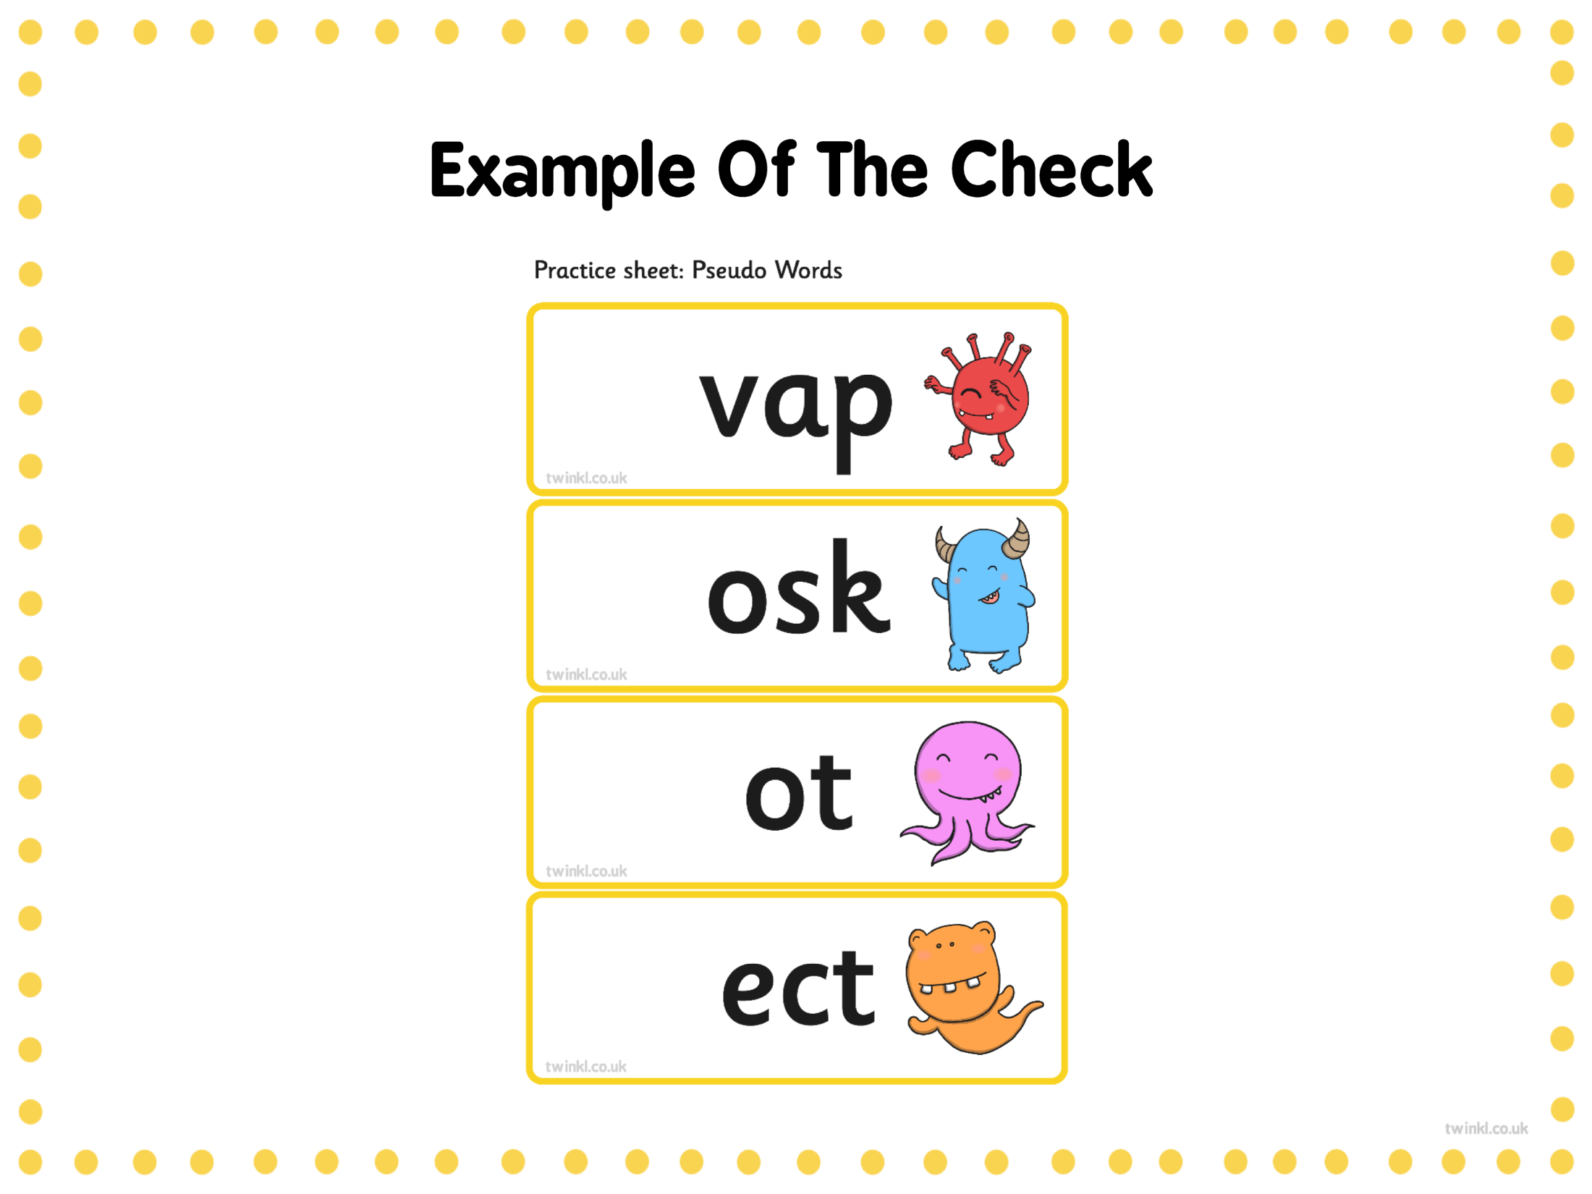
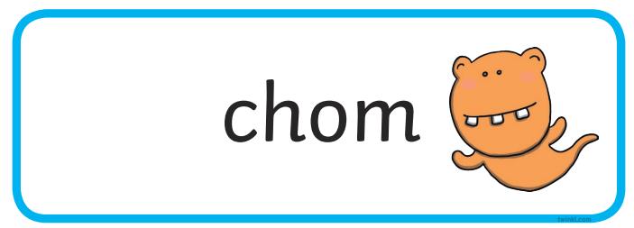
Notes:
Jen

Slide 14
Phonics Groups
Set 1 Group A
Set Group B
Set 1 Group C
Ditty
Red
Green
Purple
Pink
Orange
Yellow
Blue
Grey
End of Reception
End of Year 1
Notes:
Jen

Slide 15


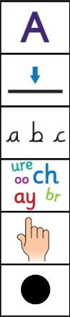
Writing
What do the children need to be able to do in their writing?
Notes:
Anna

Slide 16
Writing
To use capital letters, full stops, finger spaces and sit their letters on the line correctly.
Spelling is really important! They need to be spelling words correctly not just using phonics. Year 1 common exception words and red words should be spelt correctly (see list)
To know what nouns, verbs, adjectives, adverbs and conjunctions are and to be able to use them in their writing.
Notes:
Anna

Slide 17
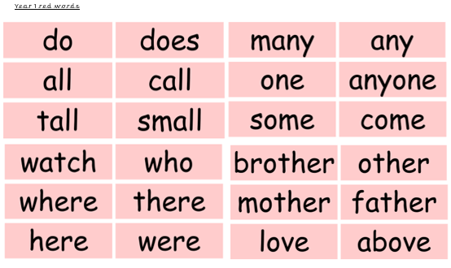
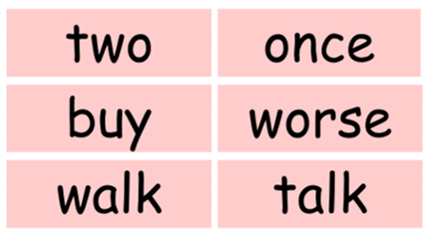
Notes:
Anna

Slide 18
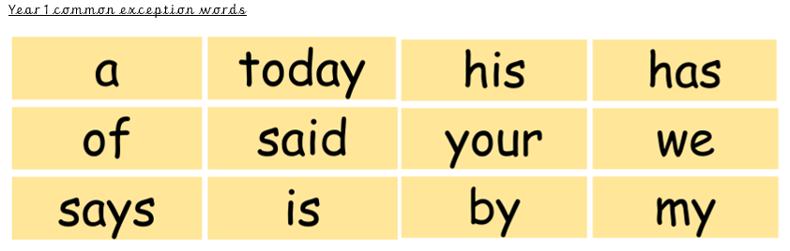
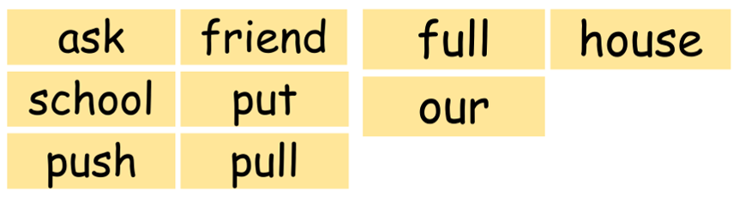
Notes:
Anna

Slide 19
Writing
To form letters starting and finishing in the right places.
For letters to be the right size in relation to one another.
For letters to sit correctly on the line.
To begin to use pre-cursive handwriting (later in the year).
Notes:
Anna

Slide 20
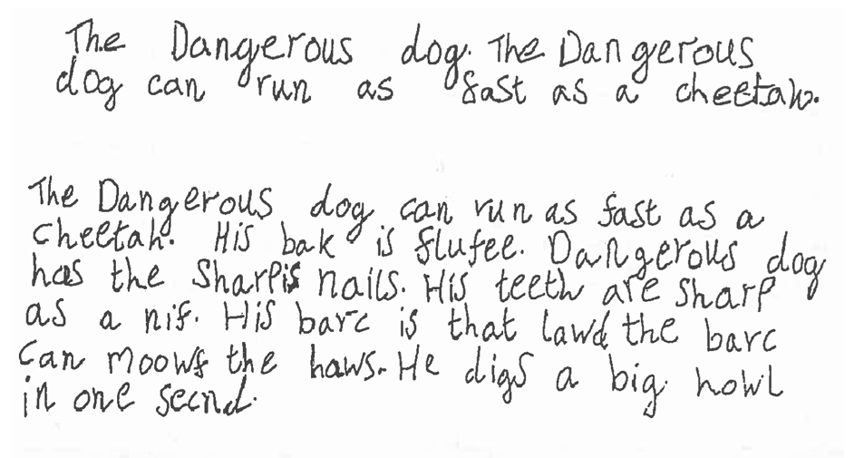
Writing
Example of end of Year 1 writing
Notes:
Anna

Slide 21
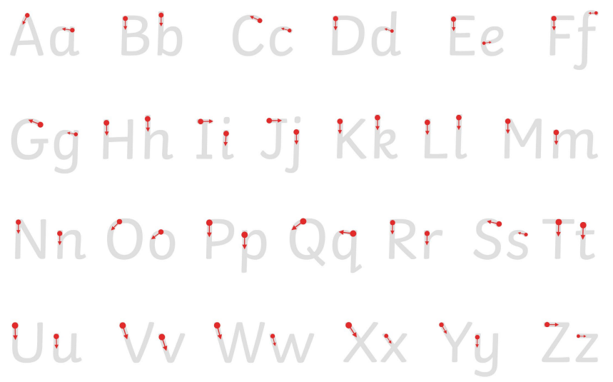
Handwriting
Children need to form lower case and capital letters in the correct way, starting and finishing in the right place.
Notes:
Cath to show new RWInc handwriting scheme? Change link

Slide 22
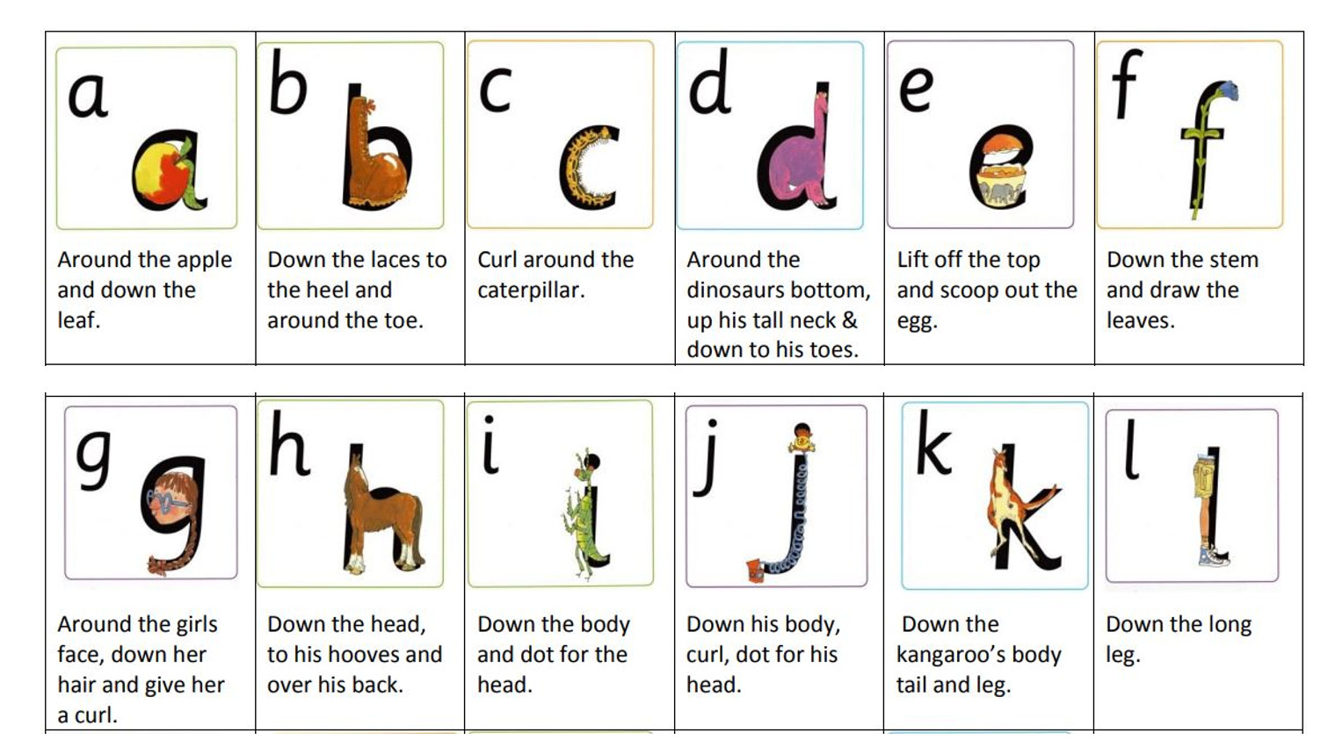
Handwriting
First ,we recap letter formation from Reception. There is a rhyme for every letter…
Notes:
Anna

Slide 23
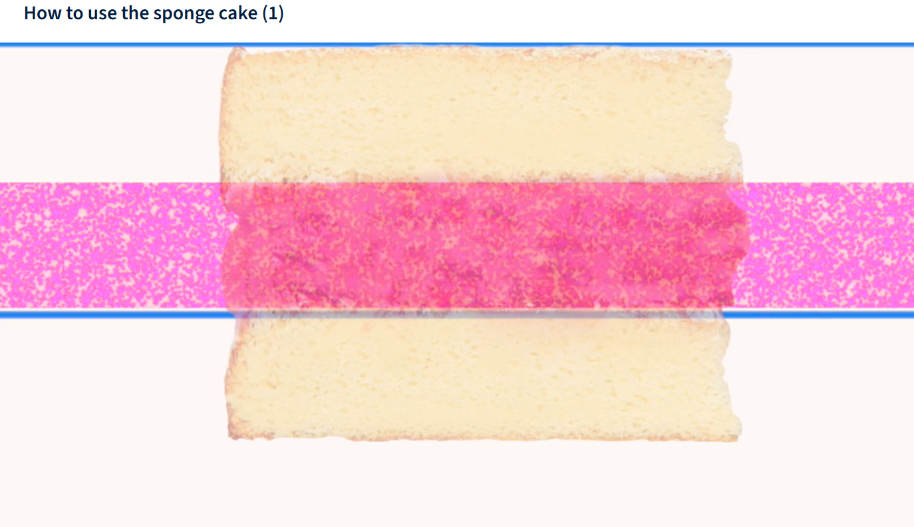
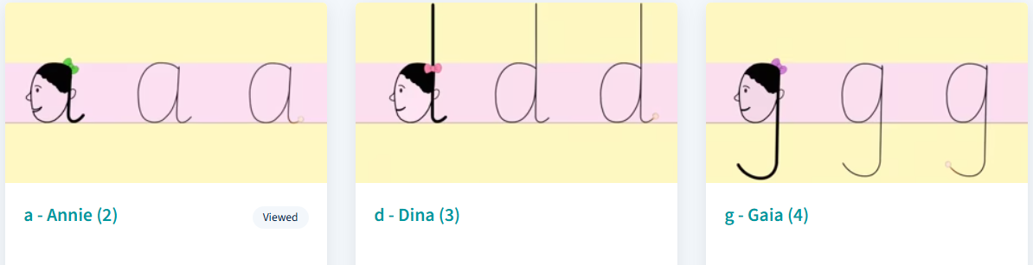
Handwriting
Then we work on the size of the letters following the RWInc handwriting scheme. It is called the ‘sponge cake’ method!
Notes:
Anna

Slide 24
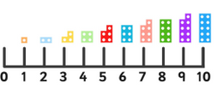
Maths
We cover:
Number and place value
Addition and subtraction
Shape
Measurement – time, length, capacity, weight
Multiplication and division
Fractions
We follow the White Rose scheme which s based on small step learning
Fluency is key. Learning number facts up to 10 will help your child in their maths ability throughout their school journey.
There is a number fact hand out sheet so you can practise at home. They need to say the answer within around 3 seconds to be fluent.
Notes:
Cath

Slide 25
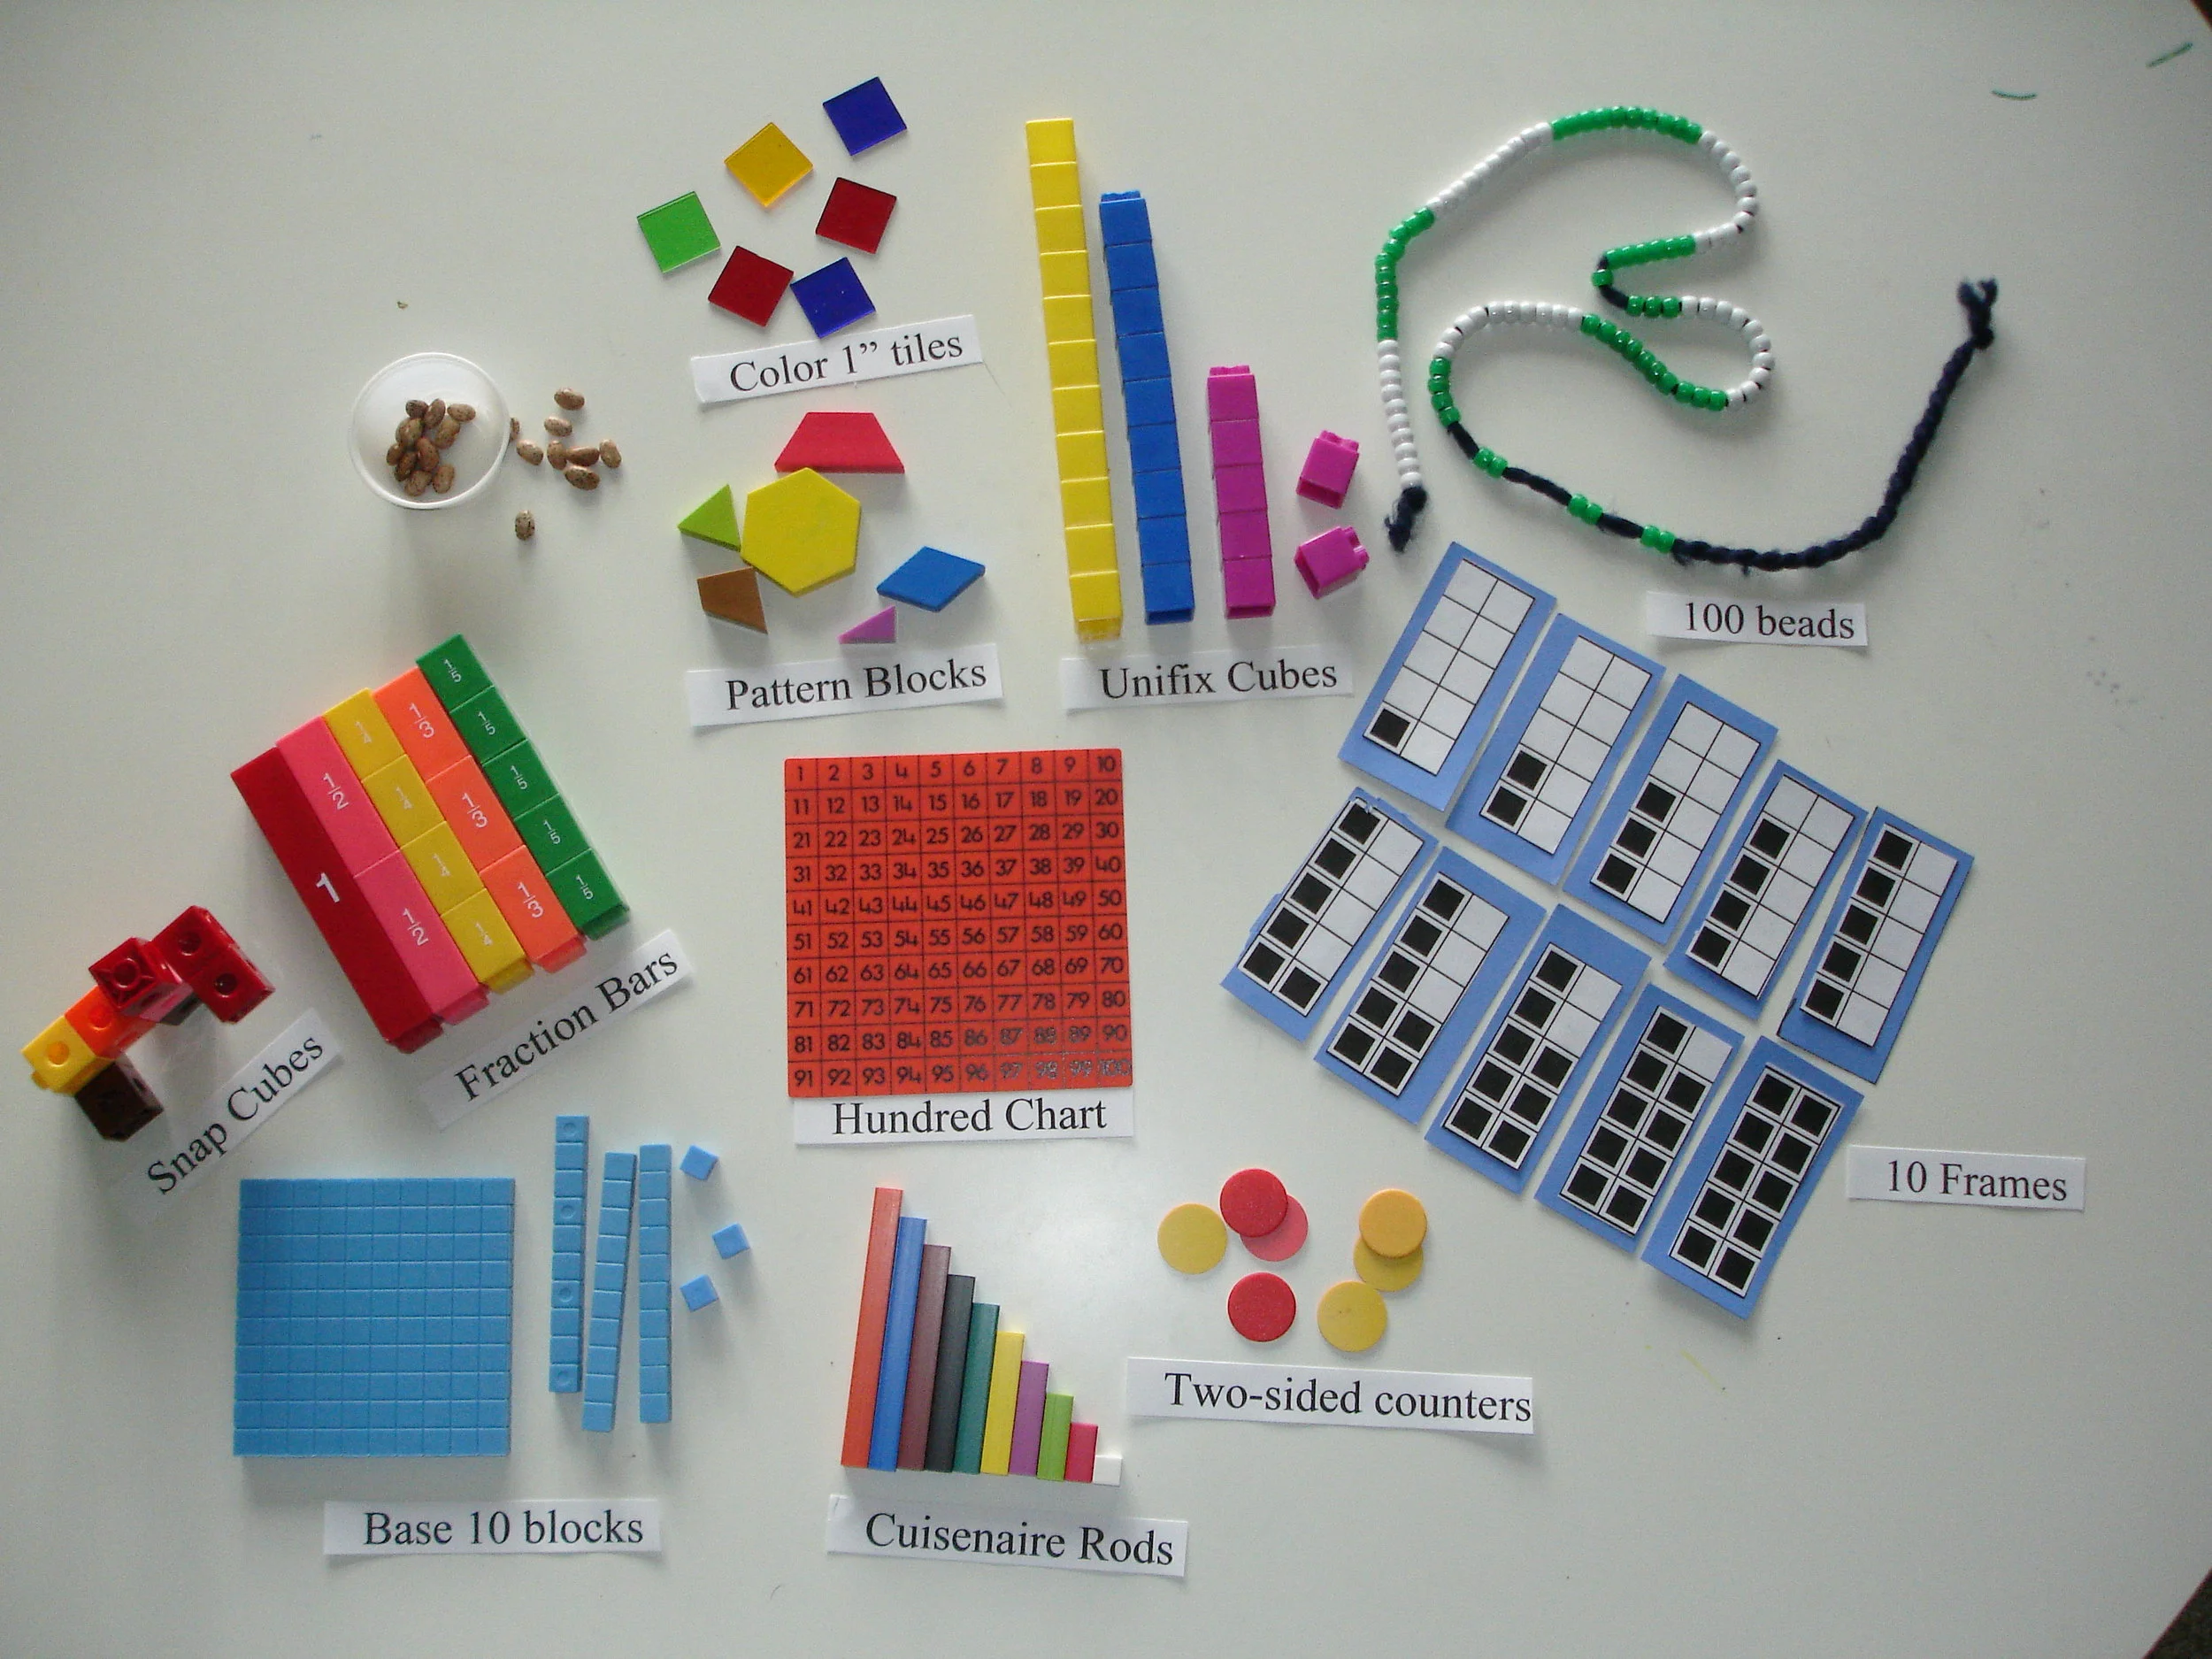
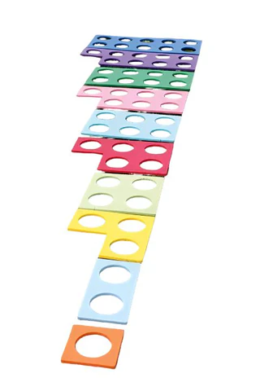
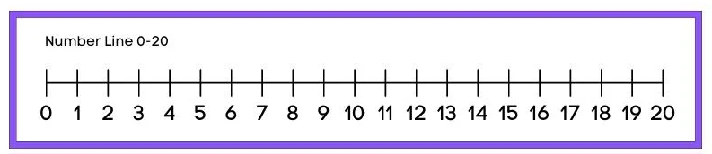
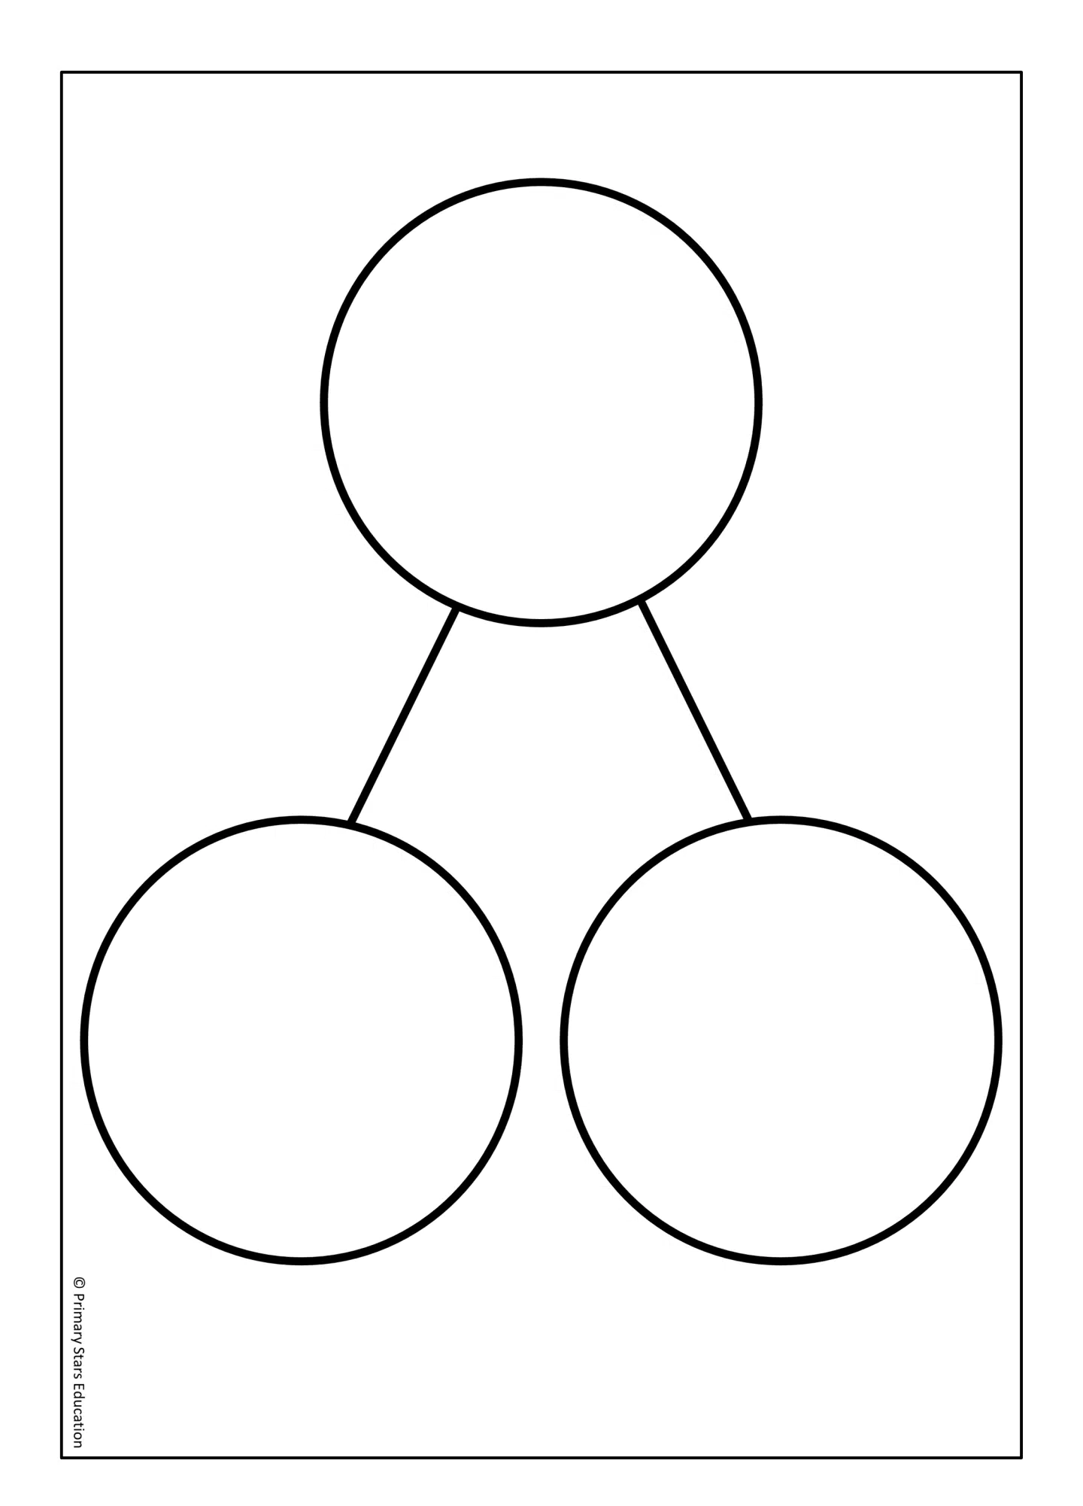
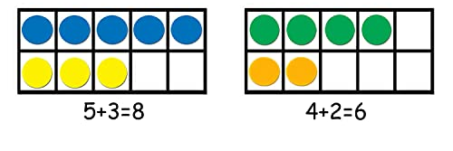
Maths
In lessons, we constantly review previous learning and do lots of practice before we move on
Being able to problem solve in all areas of maths is vital, we give the children practical and written strategies to help them.
We use equipment like tens and ones, counters, Numicon, part whole models, ten frames, hundred squares and number lines.
Notes:
Cath

Slide 26
How Can I Help My Child at Home with Reading?
You could purchase the ‘Read Write Inc’ Sound cards.
Practise reading a variety of alien words and real words.
Read as much as possible! (Phonics fluency book and book bag book).
Enjoy stories together – reading stories to your child is equally as important as listening to your child read.
Read a little at a time but often, rather than rarely but for long periods of time!
Look up definitions of words together – you could use a dictionary, the Internet or an app on a phone or tablet.
All reading is valuable – it doesn’t have to be just stories. Reading can involve anything from fiction and non-fiction, poetry, newspapers, magazines, football programmes, TV guides.
Notes:
Cath

Slide 27
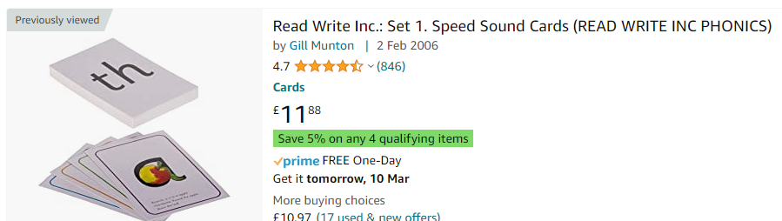
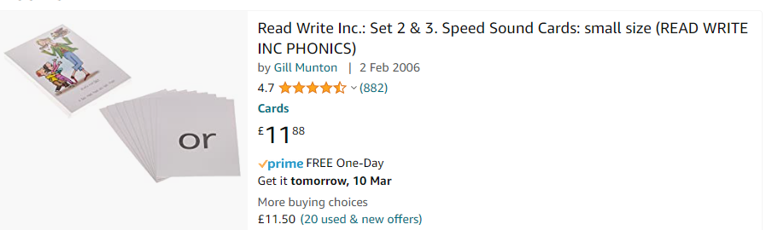
Useful Websites:
https://www.amazon.co.uk/Read-Write-Inc-Speed-PHONICS/dp/019846035X/ref=sr_1_1?crid=CUNQ1FNXAI5Q&keywords=read+write+inc+phonics+flash+cards+set+1&qid=1678378171&sprefix=read+write+inc+phonics+%2Caps%2C80&sr=8-1
https://www.amazon.co.uk/Read-Write-Inc-Speed-PHONICS/dp/0198460376/ref=sr_1_1?crid=35CD6NLC9PRMP&keywords=read+write+inc+phonics+flash+cards+set+2&qid=1696260229&sprefix=read+write+inc+phonics+flash+cards+set+2%2Caps%2C101&sr=8-1
Notes:
Cath

Slide 28
How can you help at home?
How Can I Help My Child at Home?
Ensure your child has the best possible attendance at school and comes in on time.
Support your child with any home learning tasks.
Practise and learn common exception words – make it fun!
Talk to your child about what they have learnt at school and what book(s) they are reading (the character, the plot, their opinion).
Remember to enjoy reading to your child as well as hearing them read.
Encourage independence in all areas of life (e.g. packing own book bags, writing own home learning, tying shoelaces.)
Put names in their clothing!
Notes:
Cath

Slide 29
How can you help at home?
Thank you for coming!
We appreciate your support
☺
Notes:
Cath

Slide 30
On display in the hall:
Maths equipment – ten frame, part whole model, rekenrek, double sided counters, base 10, Numicon
Phonics equipment
Reading books – RWInc paper books and book bag books
Tea/coffee
Take home:
RWInc set 1, 2 and 3 sound mat
Phonics vocab sheet
Letter formation mat (normal and pre-cursive back to back)
Red words
Year 1 and 2 CEW
Maths number facts
English sheet to say what nouns, verbs, adjectives, adverbs and conjunctions are and to be able to use them in their writing.
Extra work pack to support their child’s phonics

