Slide 1

Welcome to our Year 2 Writing meeting

Slide 2
How do we teach writing at The Canons?
Letter formation
Phonics (FRED fingers) in to spelling
Red words / common exception words
Build a sentence
Hold a sentence
Writing a sentence independently using a capital letter and a full stop.
Teaching the Y1 and Y2 spelling rules.
This is built upon in Year 1 and 2.

Slide 3
Handwriting and Spelling

Slide 4
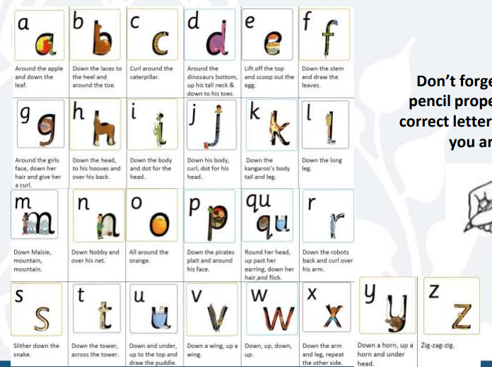
Handwriting and letter formation – Step 1 – print letters

Slide 5
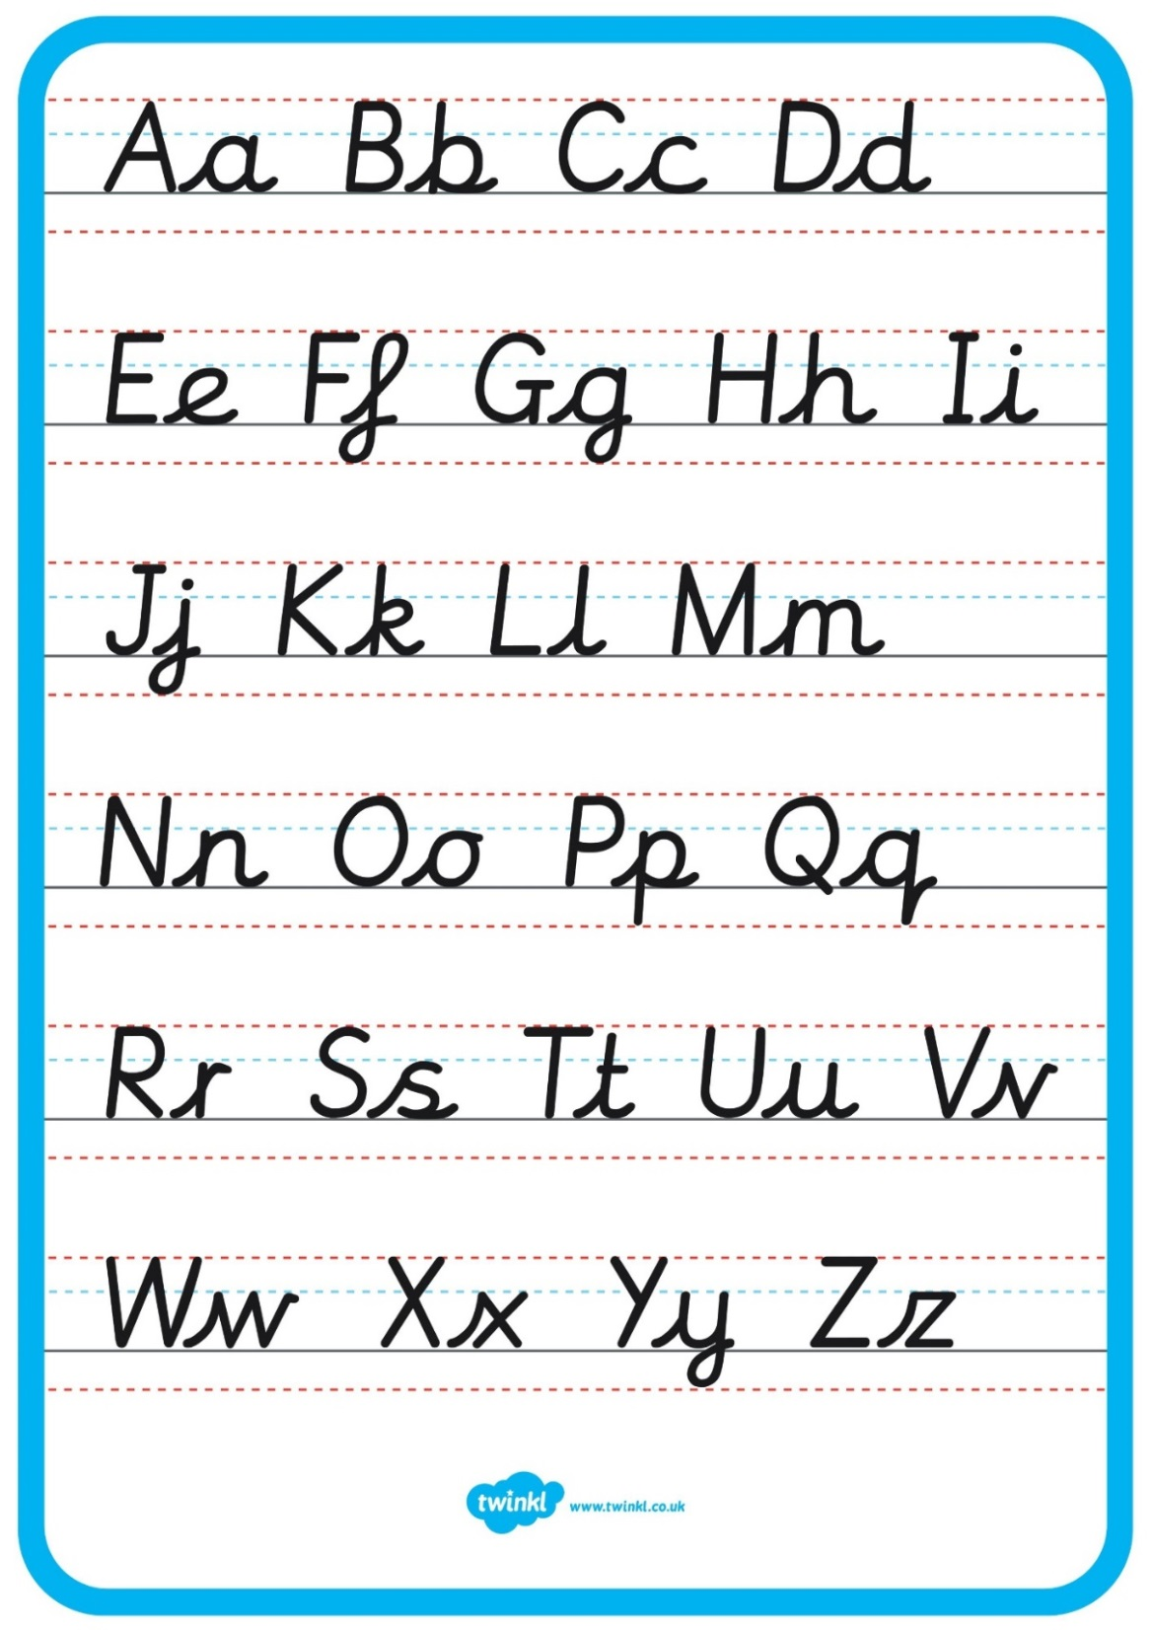
https://teachhandwriting.co.uk/continuous-cursive-beginners-choice-3.html
Handwriting and letter formation – Step 2 – pre-cursive

Slide 6
Handwriting and letter formation – Step 3 - cursive

Slide 7
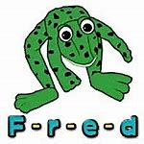

Spelling in Year 2
Use Fred Fingers for sounds in words
Use syllable approach. Give them the sounds then they build the word. Move onto choosing own sounds independently.
a tten tion
del i cious
Know how to spell words for the Year 1 and 2 spelling rules
Use a dictionary!

Slide 8
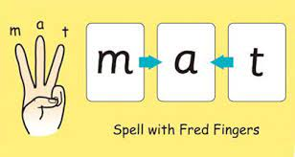
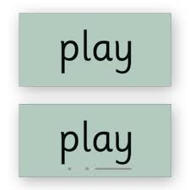
Using phonics to spell – Fred Fingers
green
goat
waiting
knowing

Slide 9
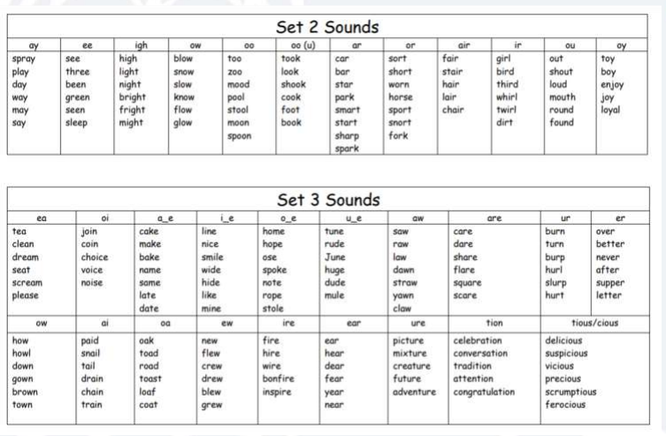

Slide 10
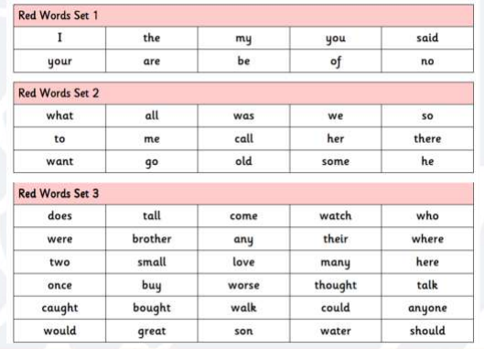

Slide 11
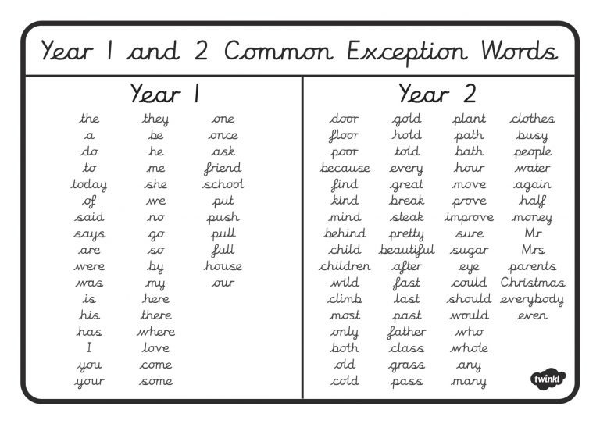

Slide 12
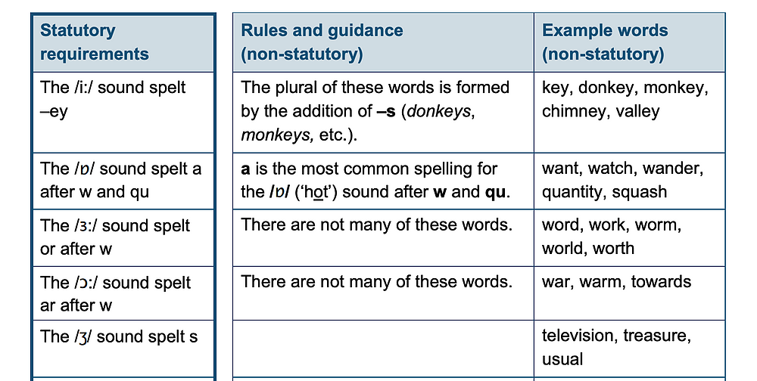
Spelling Rules - Year 2
https://assets.publishing.service.gov.uk/government/uploads/system/uploads/attachment_data/file/239784/English_Appendix_1_-_Spelling.pdf

Slide 13
Grammar and Punctuation

Slide 14
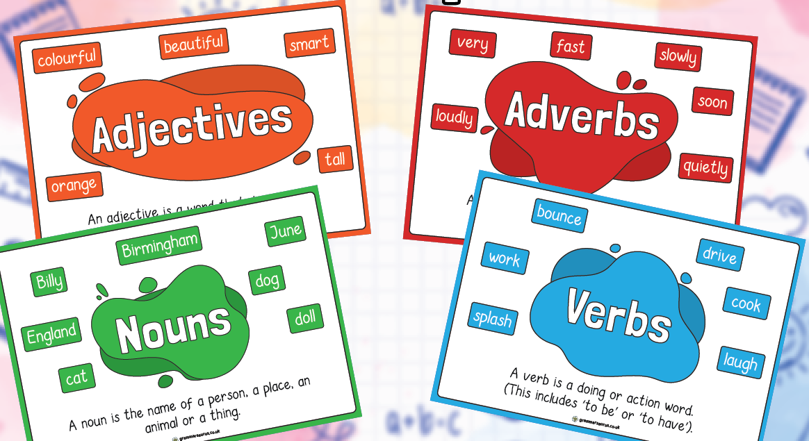
Word types:

Slide 15
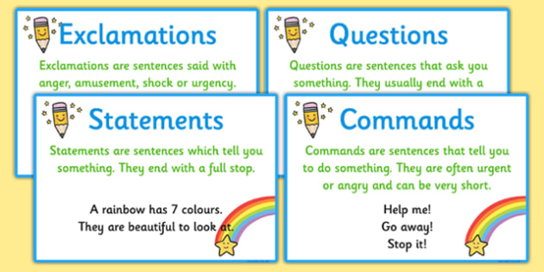
Sentence types:

Slide 16
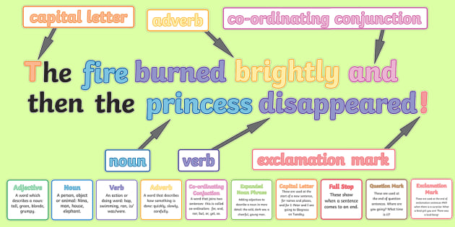
What is a sentence?

Slide 17
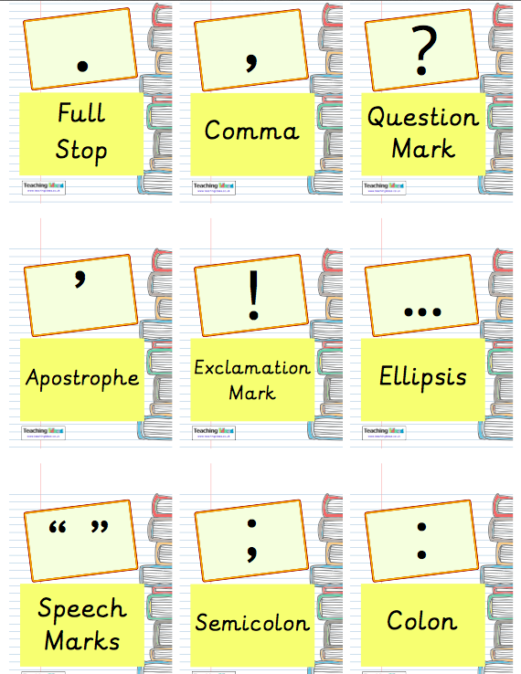
Punctuation

Slide 18
Spelling, Punctuation and Grammar
This test is non-statutory this year and will not be reported nationally. However we still need to do the paper to contribute towards the assessment of writing.
The test consists of two separate papers:
Paper 1: spelling (20 marks).
Paper 2: questions (20 marks).
chapter
menu
next page

Slide 19
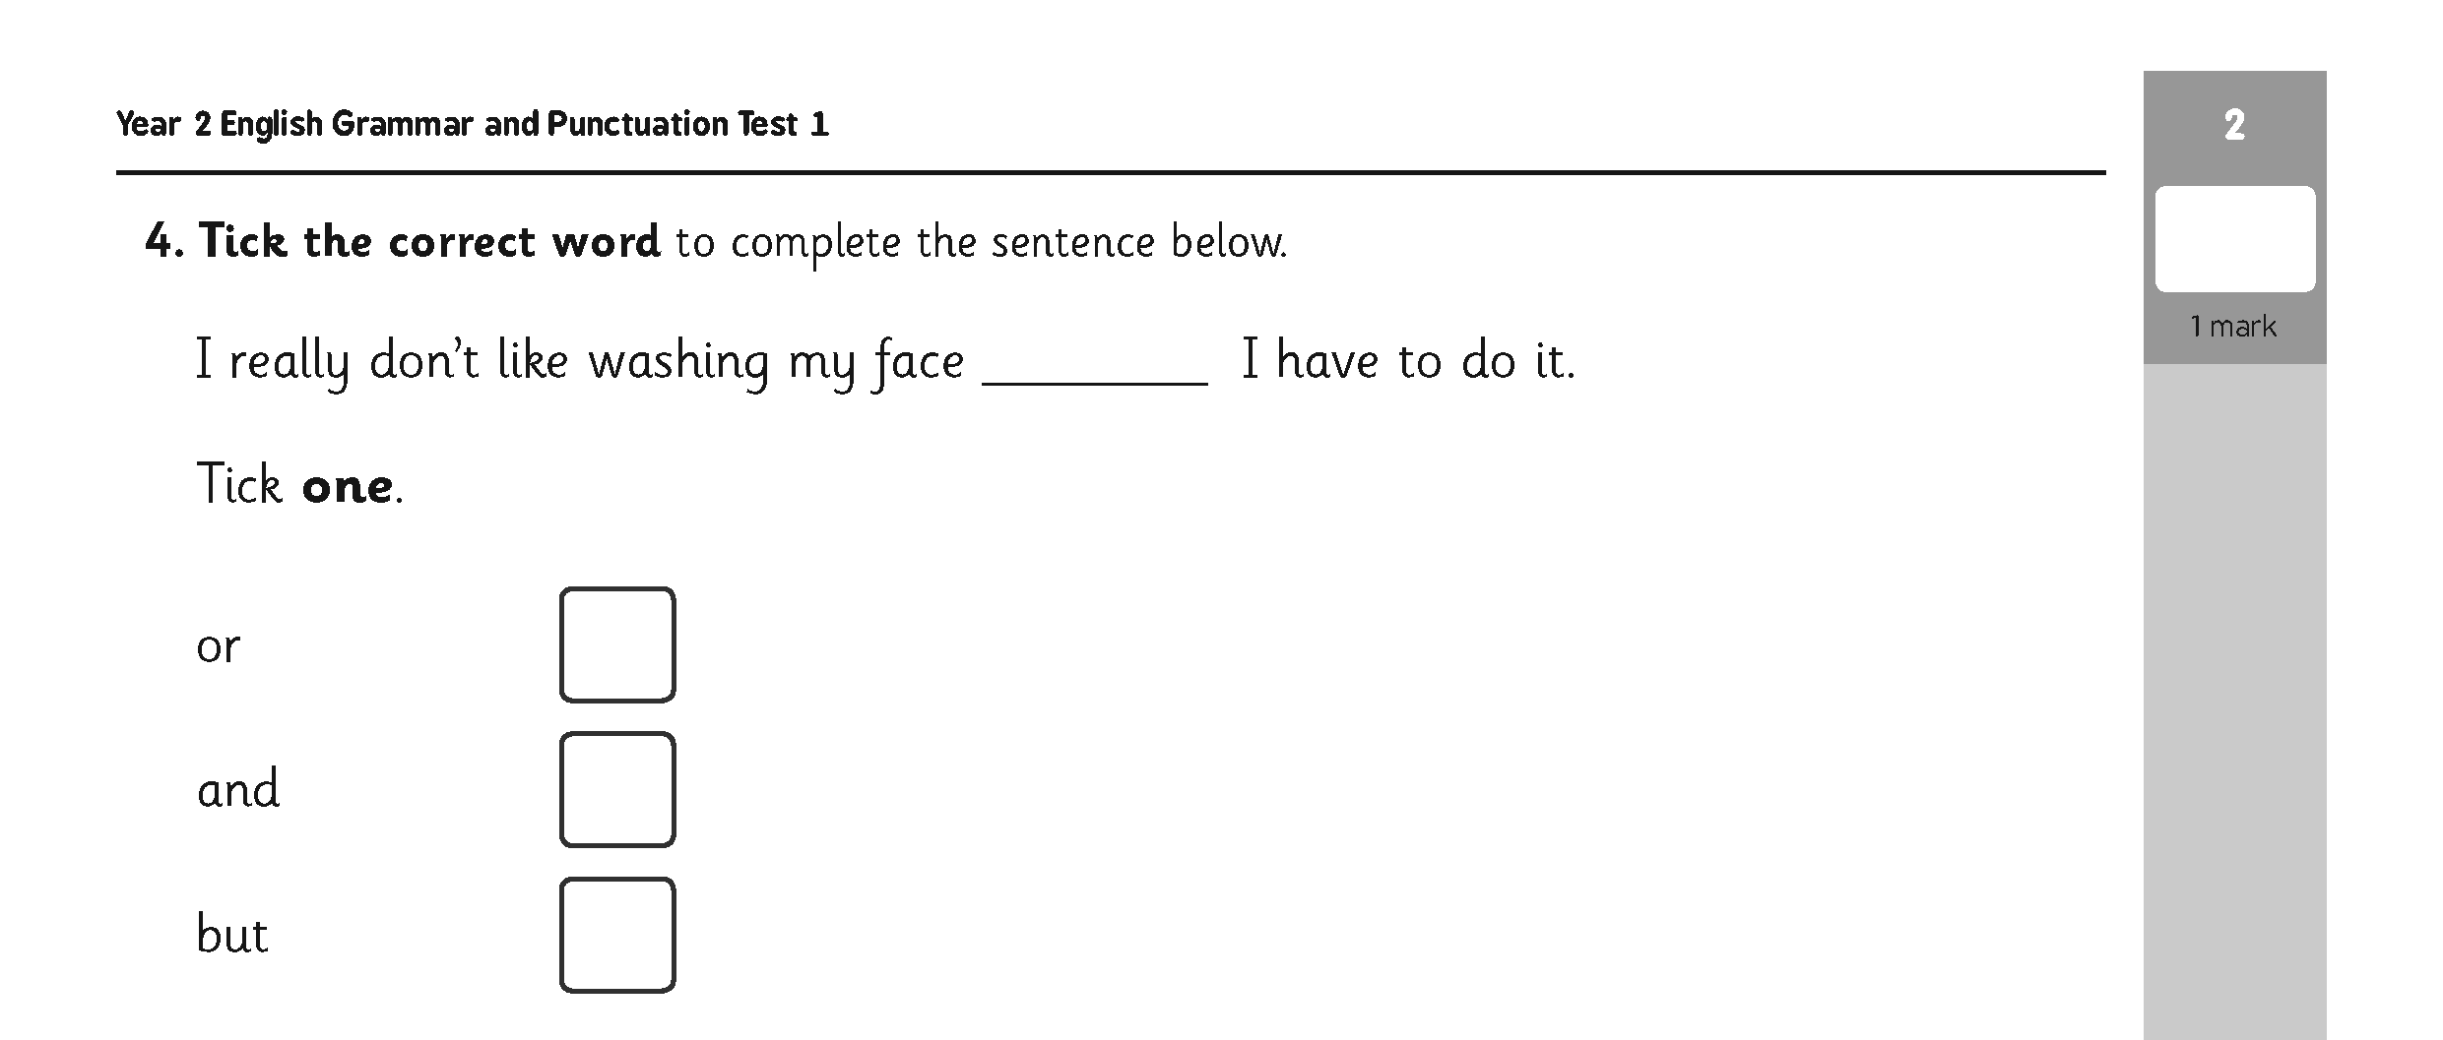
Sample Questions
Grammar, Punctuation and Vocabulary Paper
chapter
menu
next page

Slide 20
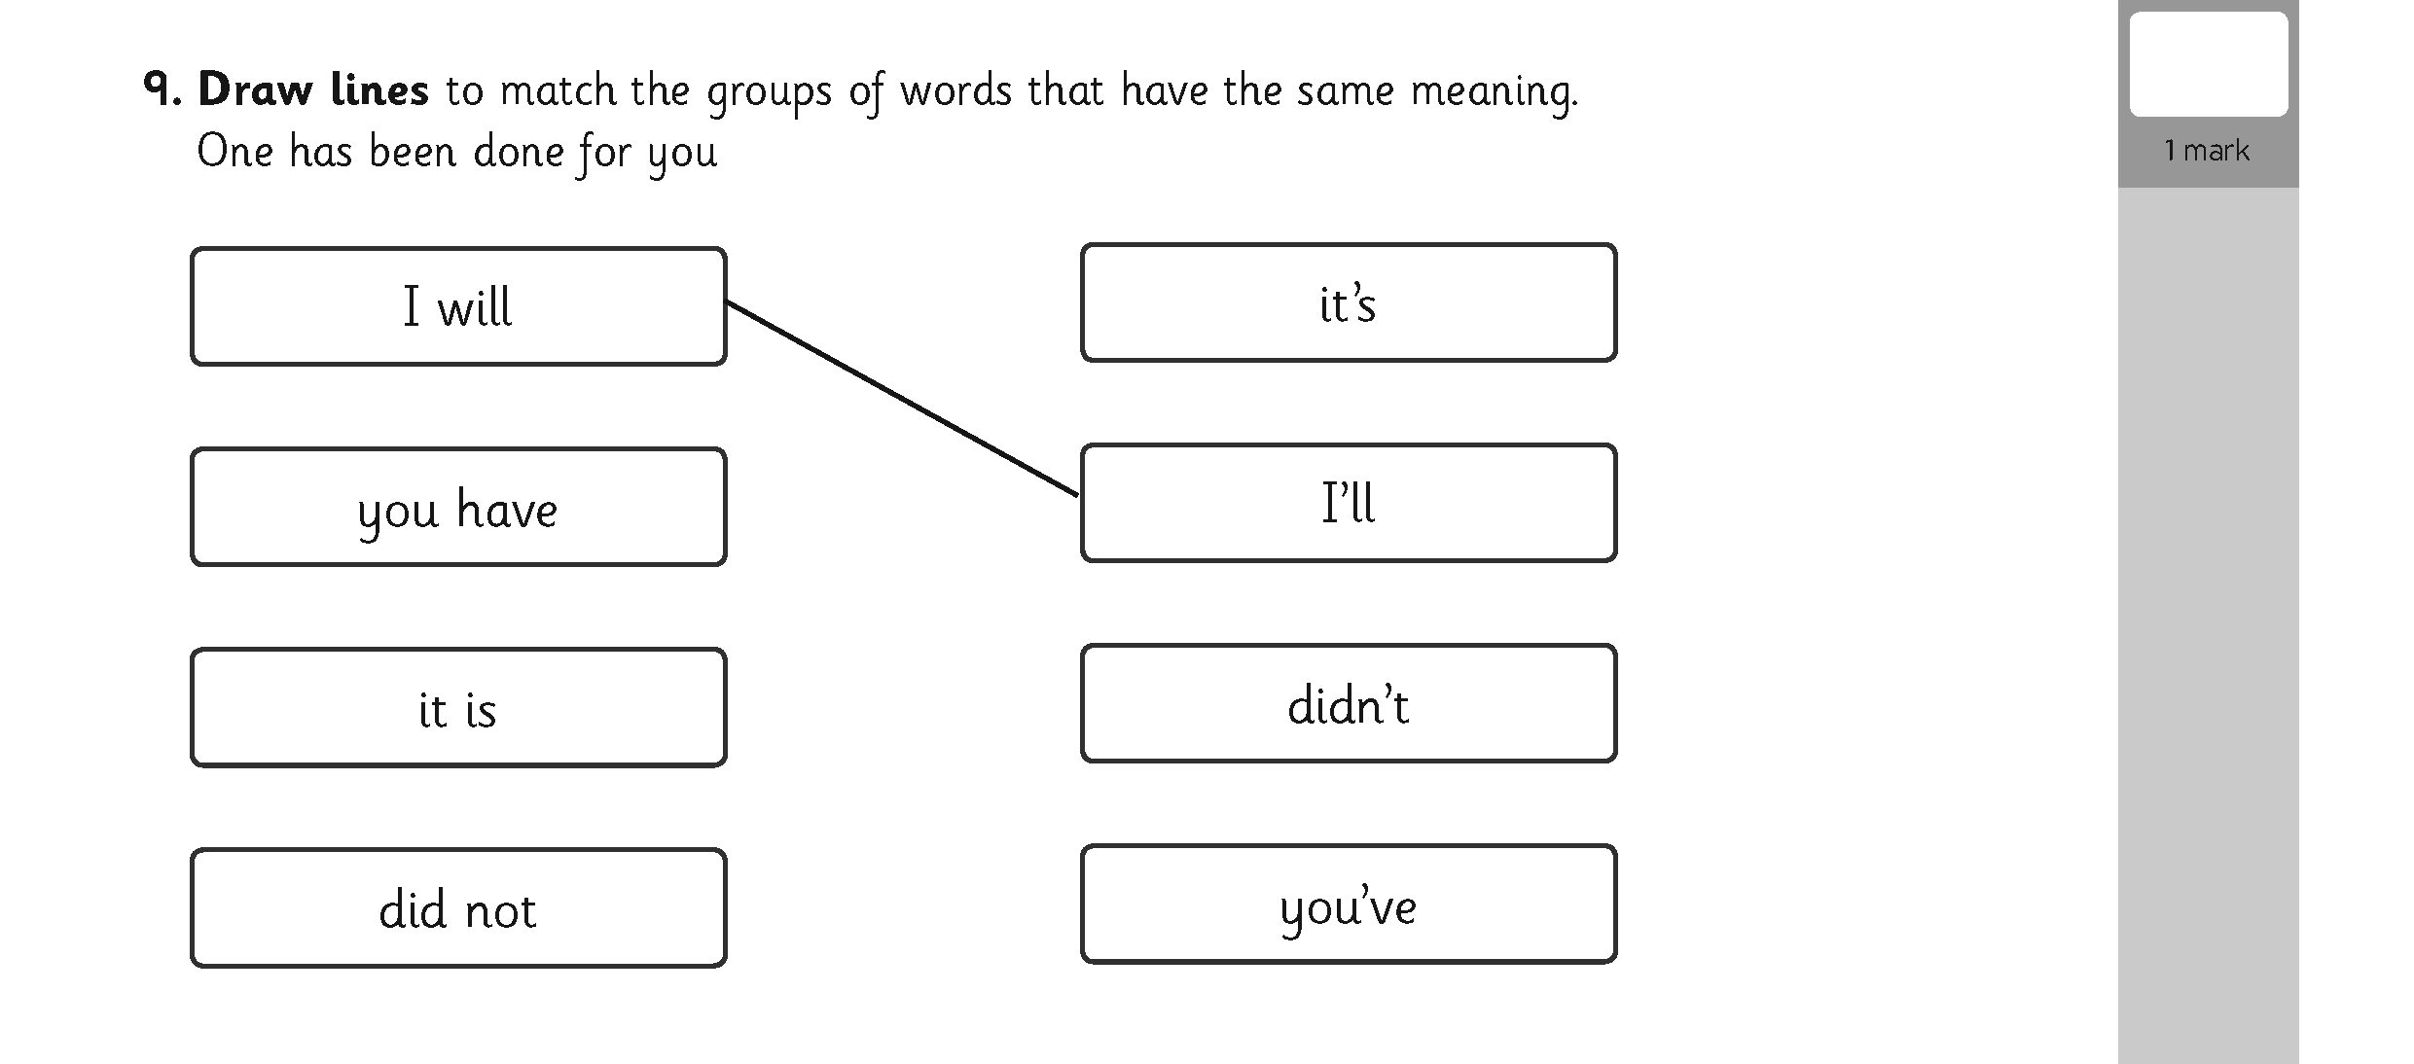
Sample Questions
Grammar, Punctuation and Spelling Paper
chapter
menu
next page

Slide 21
Writing

Slide 22


Writing in Year 2
Use pre-cursive/cursive writing.
We are working on stamina and pace. At this time of the year we would expect children to produce at least 2/3 of an A4 page of quality writing. By the end of the year it should be a full page.
Spelling is really important! They need to be spelling words correctly not just using phonics. Year 1 and 2 common exception words should be spelt correctly.

Slide 23
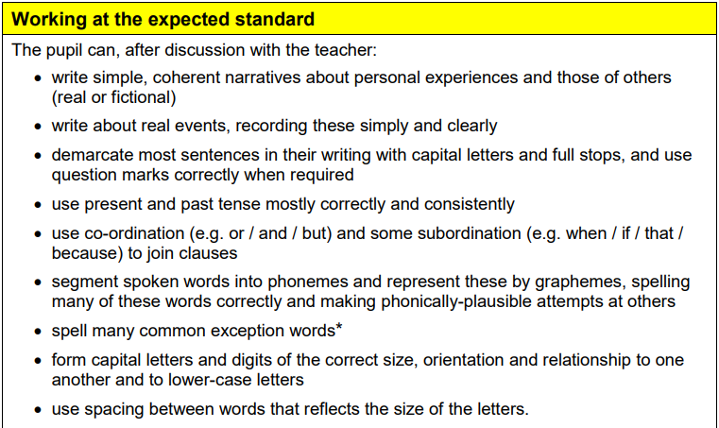
By the end of Year 2…

Slide 24
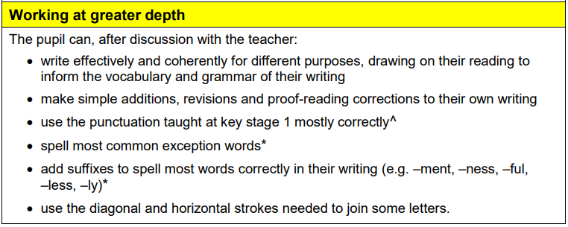

Slide 25
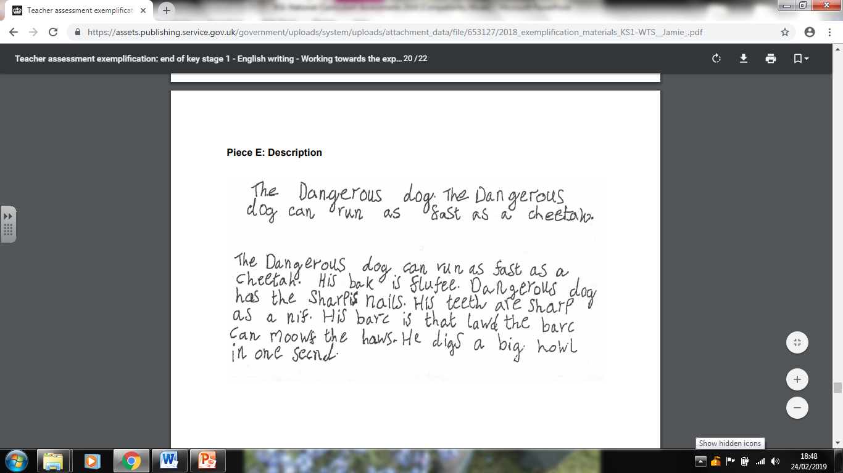
Sample Writing – Working Towards
chapter
menu
next page

Slide 26
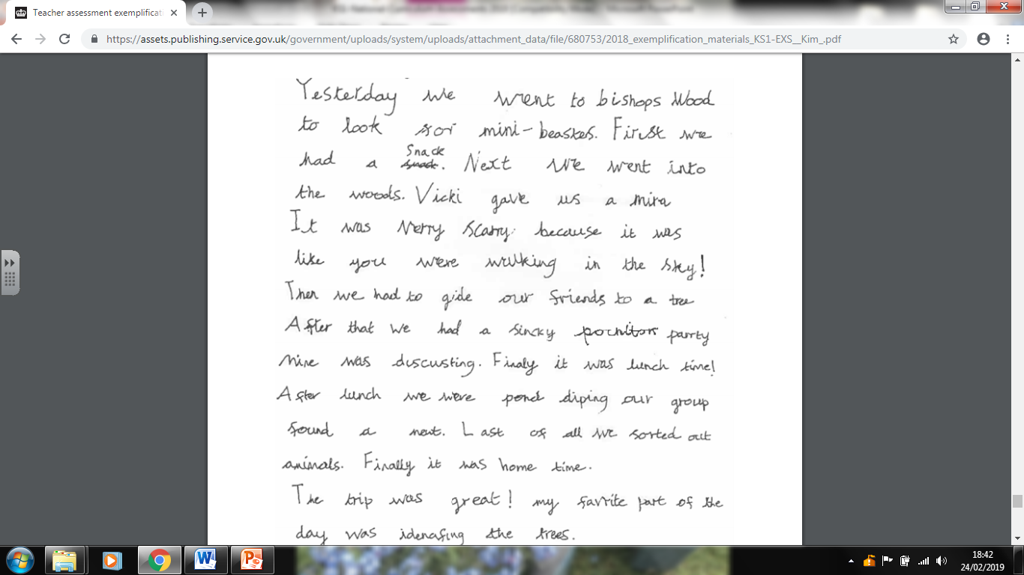
Sample Writing – Expected standard
chapter
menu
next page

Slide 27
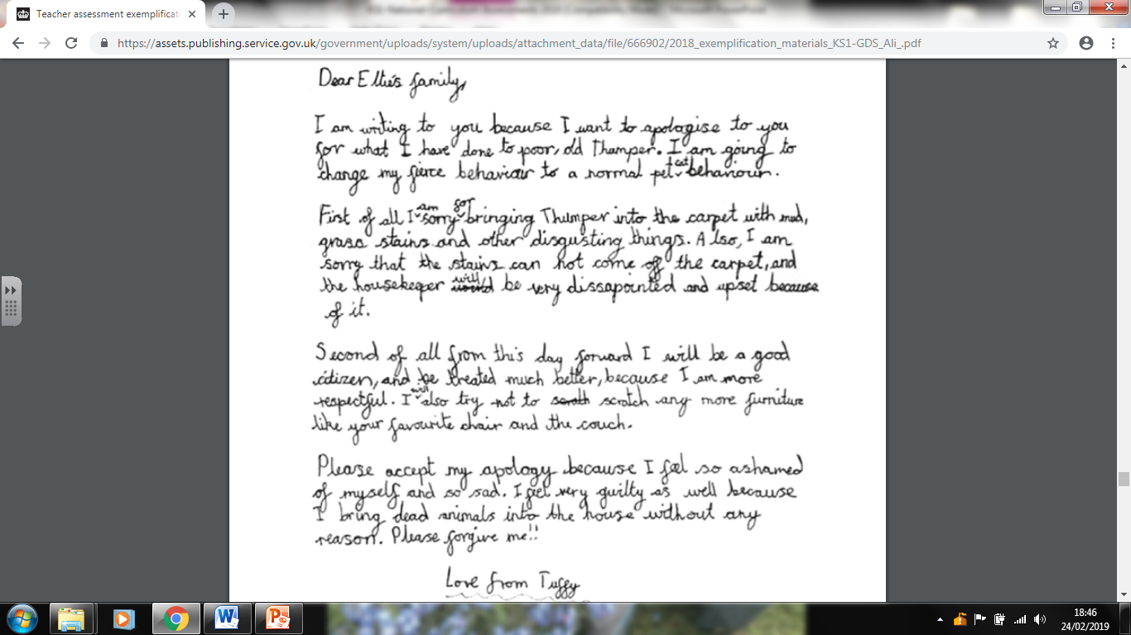
Sample Writing – Greater Depth
chapter
menu
next page

Slide 28
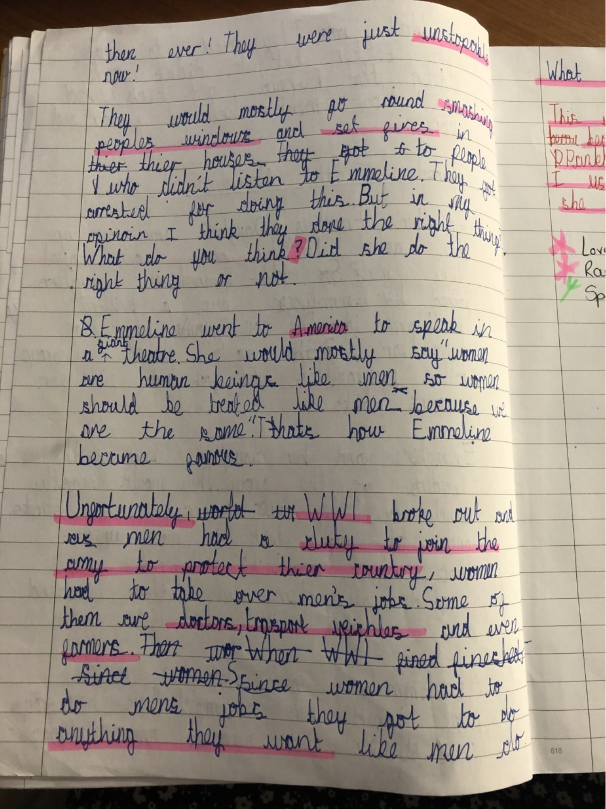

Slide 29
How to Help Your Child with Writing

Slide 30
How to Help Your Child with Writing
Practise and learn weekly spelling lists – make it fun!
Encourage opportunities for writing, such as letters to family or friends, shopping lists, notes or reminders, stories or poems.
Write together – be a good role model for writing.
Encourage use of a dictionary to check spelling.
Allow your child to use a computer for word processing, which will allow for editing and correcting of errors without lots of crossing out.
Remember that good readers become good writers! Identify good writing features when reading (e.g. vocabulary, sentence structure, punctuation).
Show your appreciation: praise and encourage, even for small successes!
Practise and learn common exception words – make it fun!
Encourage opportunities for writing, such as letters to family or friends, shopping lists, notes or reminders, stories or poems.
Write together – be a good role model for writing.
Encourage use of a dictionary or thesaurus to check spelling.
Allow your child to use a computer for word processing, which will allow for editing and correcting of errors without lots of crossing out.
Remember that good readers become good writers! Identify good writing features when reading (e.g. vocabulary, sentence structure, punctuation).
Show your appreciation: praise and encourage, even for small successes!

Slide 31
How can you help at home?
Ensure your child has the best possible attendance at school and comes in on time.
Support your child with any homework tasks.
Spelling is always good to practise.
Practise and learn common exception words – make it fun!
Talk to your child about what they have learnt at school
Make sure that your child has a good sleep and healthy breakfast every morning!
Encourage independence in all areas of life. (e.g. packing own book bags, writing own homework, tying shoelaces.)

Slide 32
Time for questions…
We will upload the PowerPoint on the website
Thank you for joining us – we hope you found it useful!

