Slide 1
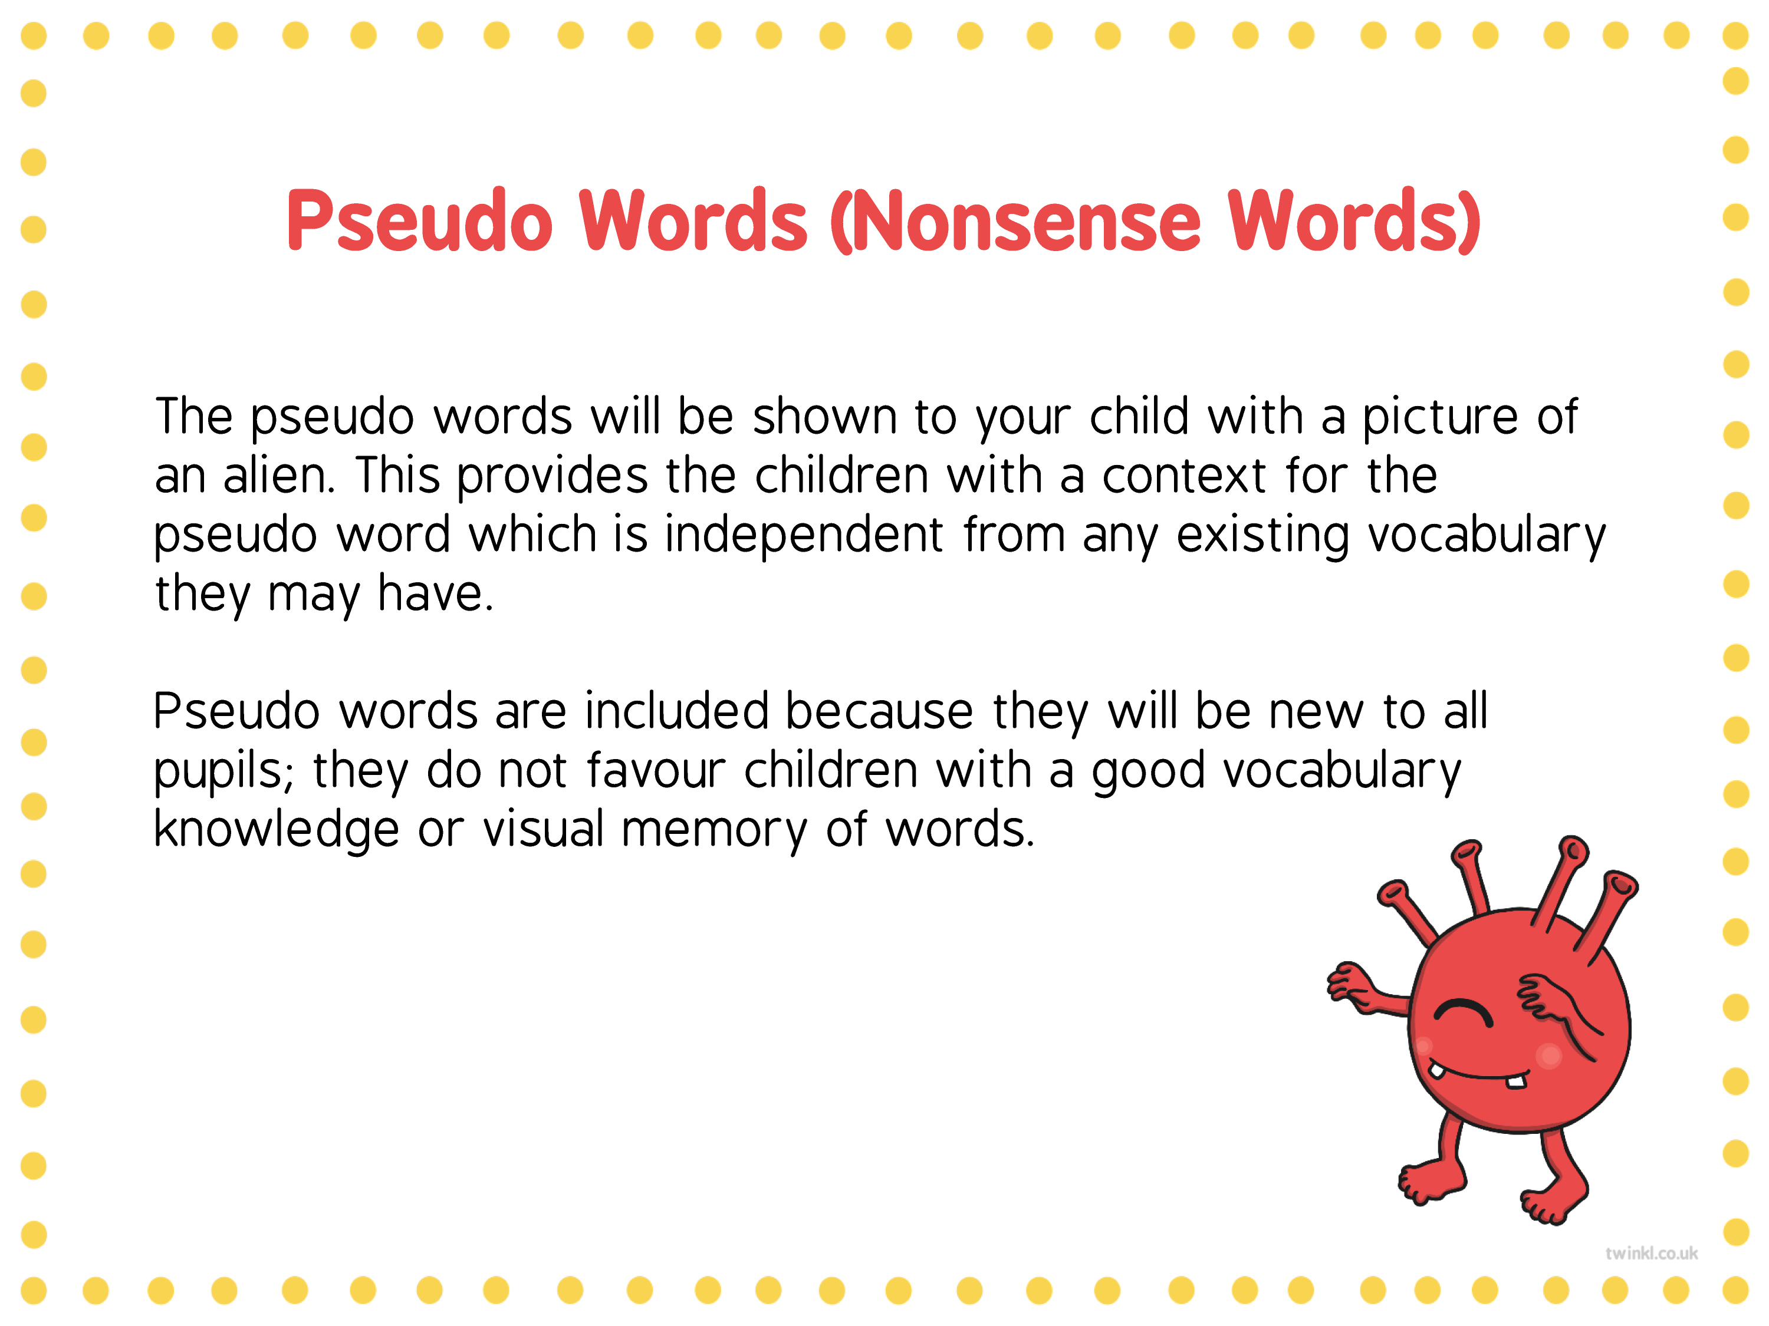
Welcome to our
Year 2
Curriculum Meeting

Slide 2
What is the same from Year 1?
Children still change their own reading books in the classroom and are expected to read 3 times a week at home with an adult.
Homework is sent home weekly. We give it out on a Friday and the children should hand it in by Thursday.
Phonics still happens every day but this will soon move onto reading comprehension and spelling.

Slide 3
What is the different from Year 1?
Children need to become more responsible and independent in and out of school to be resilient learners.
Pace is quicker!

Slide 4
Year 2 Curriculum
Autumn 1 (8 weeks) | Autumn 2 (7 weeks)
Super Duper You– Geography, History and Science focus Bedworth town – human and physical features and how it has changed over time (including mining) Hygiene, Balanced Diet, Exercise Trip –Bedworth | Little People, Big Dreams – History focus Guy Fawkes – Gunpowder plot Armistice Day – WW1 Emmeline Pankhurst – Women’s rights Rosa Parks – Black history Queen Elizabeth II – In our lifetime George Eliot - Local Trips – Riversley Park Museum
Spring 1 (6 weeks) | Spring 2 (7 weeks)
Winter Wonderland – Geography and Science focus Antarctica compared with Bedworth, Oceans and Continents Habitats and Animal Survival | Precious Plants – Science focus What a plant needs and germination
Summer 1 (4 weeks) | Summer 2 (7 weeks)
Wriggle and Crawl – Science focus Food chains and Life cycles Trip – Hartshill Hayes | Beside the Seaside – History, Geography and Science focus Human and Physical features of the seaside including comparison to Bedworth. Changes over time to the seaside and why people visit Materials – choosing them for a purpose (creating a boat)

Slide 5

SATs Tests
We no longer complete SATs formally as this is now an option
for schools. The tests are used as our end of year data and
will be completed in June/July as further evidence to make a
final teacher judgement (working towards, expected level,
greater depth).
At the end of Year 2, children will take assessments in:
Reading (2 comprehension papers)
Maths (2 papers; arithmetic and reasoning)
English grammar, punctuation and spelling
Writing is assessed throughout the year from the work in their books combined with the GPS score.

Slide 6
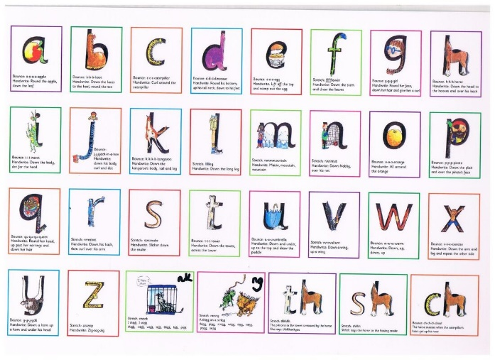
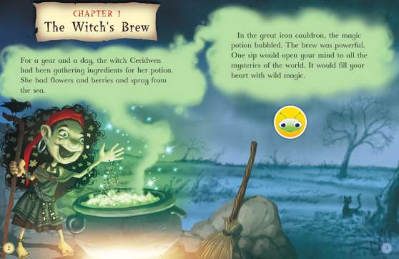
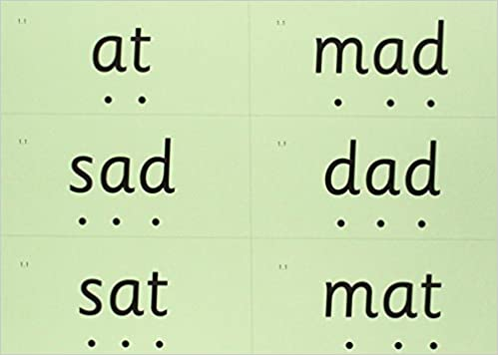
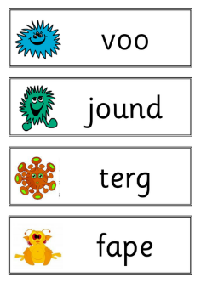

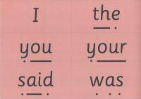
How do children learn to read at The Canons?
Phonics sounds and red words
Blending the sounds to make green words and alien words
Reading texts fluently and understanding what they are reading

Slide 7


Reading in Year 2
Children need to be fluent readers (90 words a minute at the level they are reading).
Understand what they are reading and answer questions about the text.
Read different types of texts.
Read with an adult as often as possible (3 times a week to earn a raffle ticket).
Move up on book bands when they have shown they can read fluently, show they understand what they read and have completed a Bug Club Assessment in school.

Slide 8
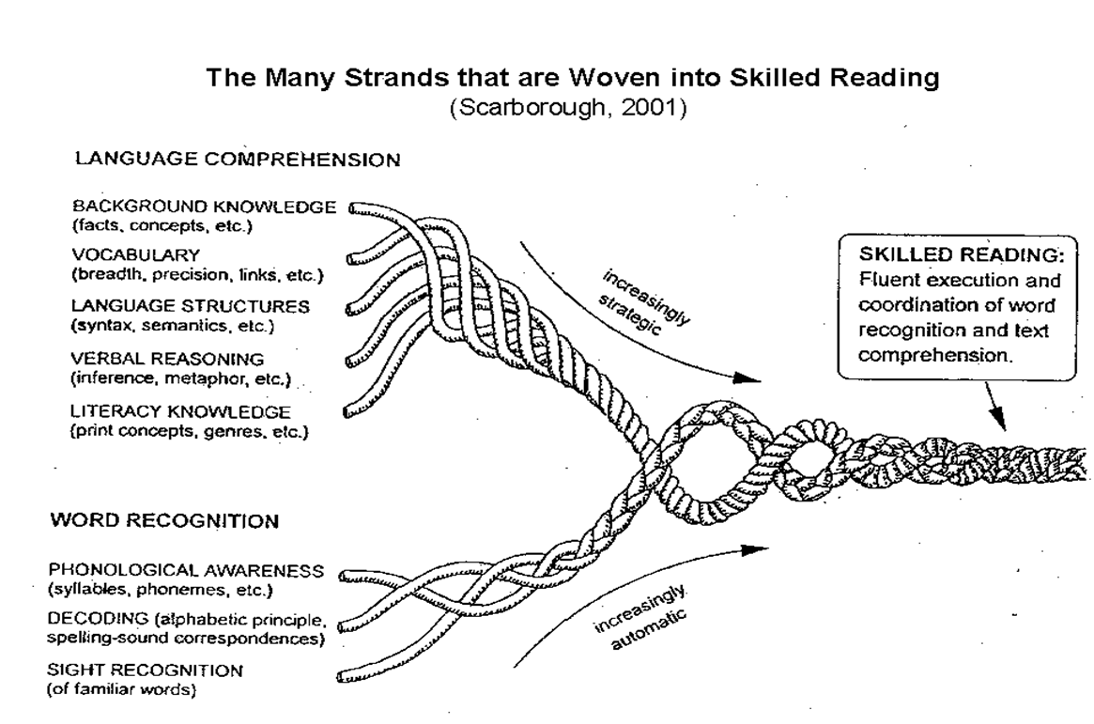
The rope reading model
A good reader looks like this:

Slide 9

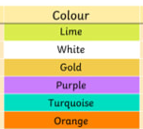
Book Bands
https://www.activelearnprimary.co.uk/login?c=0
End of Year 2
Start of Year 2

Slide 10


Writing in Year 2
Use pre-cursive/cursive writing.
We are working on stamina and pace. At this time of the year we would expect children to produce at least 2/3 of an A4 page of quality writing. By the end of the year it should be a full page.
Spelling is really important! They need to be spelling words correctly not just using phonics. Year 1 and 2 common exception words should be spelt correctly. (See lists)

Slide 11
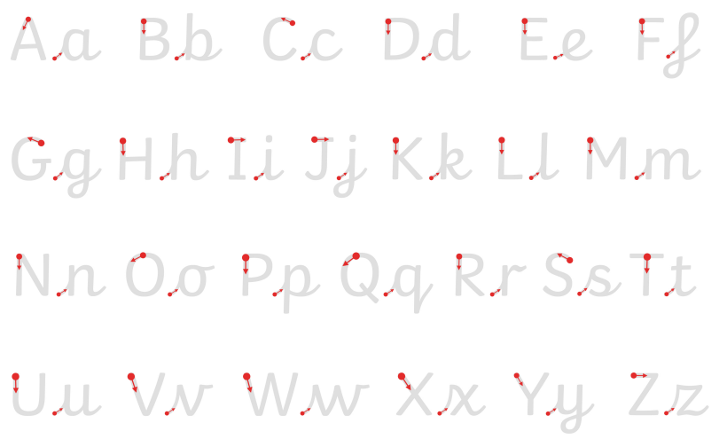
This is how we will be teaching pre-cursive…
https://teachhandwriting.co.uk/continuous-cursive-beginners-choice-3.html

Slide 12
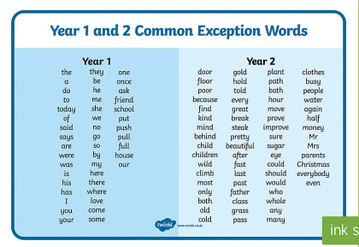

Slide 13


Spelling in Year 2
Use Fred Fingers for sounds in words
Use syllable approach. Give them the sounds then they build the word. Move onto choosing own sounds independently.
    A tten tion
    Del i cious
Know how to spell words for the Year 1 and 2 spelling rules (list in pack)
Use a dictionary!

Slide 14
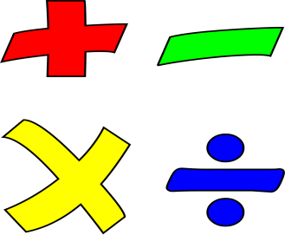
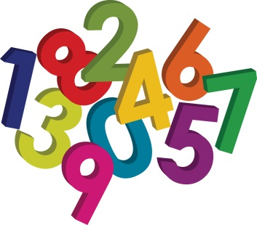
Maths in Year 2
Number facts are vital and the foundation on which we build.
We learn mental and written strategies to add, subtract, multiply and divide numbers.
Being able to problem solve in all areas of maths is vital.
We use equipment like tens frames and double sided counters, tens and ones rods, numicon, hundred squares and number lines first, then draw pictures and then write the numbers.

Slide 15
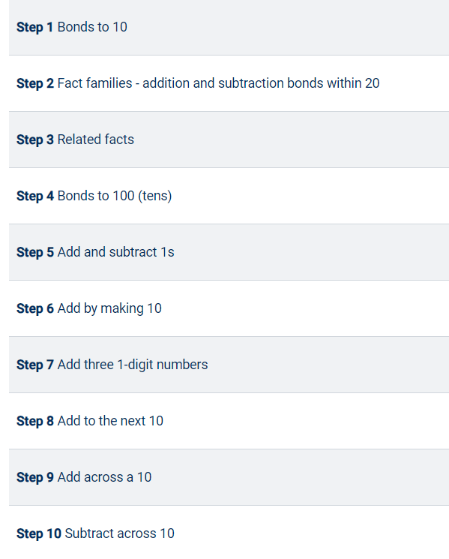
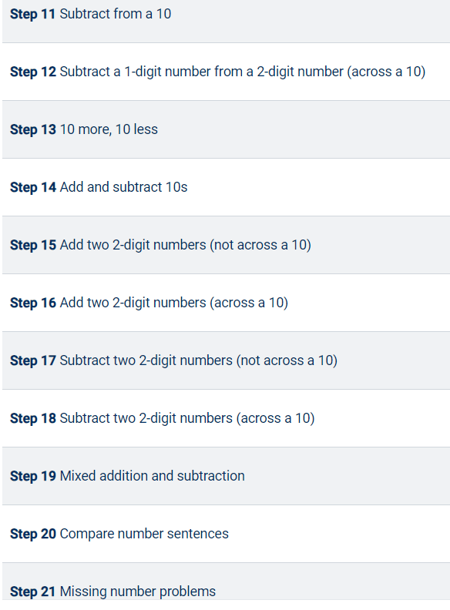
Adding and Subtracting

Slide 16
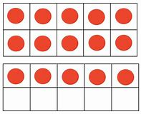
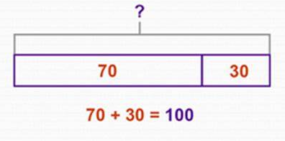
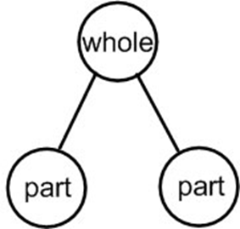
Concrete | Pictorial | Abstract
Tens frame
Bar model
Expanded column method
Tens Ones
4
2
40 + 6 = 46
Part whole diagram

Slide 17
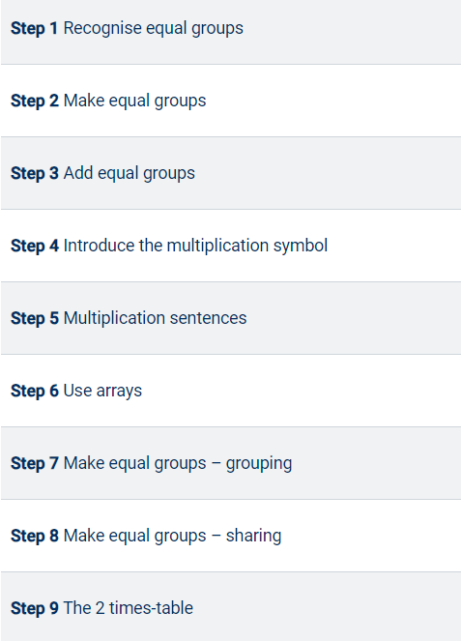
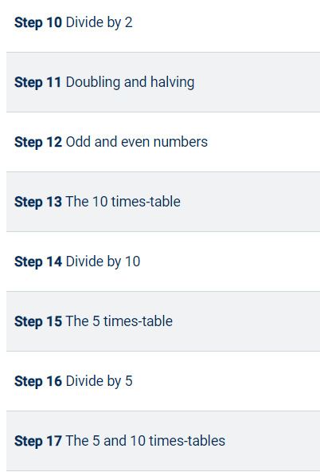
Multiplication and Division

Slide 18
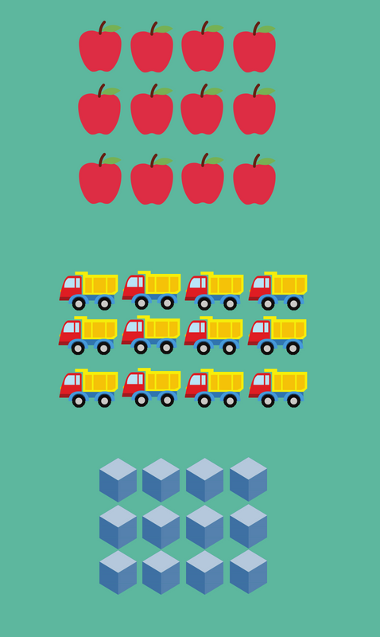
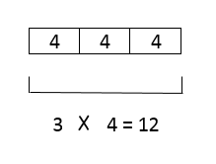
Concrete | Pictorial | Abstract
Counters
Arrays (rows)
Recalling multiplication and division facts including 2, 3, 5 and 10.
2 x 5 = 10
10 ÷ 2 = 5
3 x 10 = 30
30 ÷ 10 = 3
Bar model

Slide 19
How to help your child with Maths
Numberline + and – (counting forwards and backwards)
Use methods like expanded column method
Draw diagrams like part whole/Bar model
Use equipment (anything) to represent the tens and ones
Use facts that you know to help you (pairs to 10, number facts)
Practise time, shape and money as much as possible when out and about

Slide 20
How can you help at home?
Ensure your child has the best possible attendance at school and comes in on time.
Support your child with any homework tasks.
Reading, spelling and arithmetic (e.g. times tables) are always good to practise.
Practise and learn common exception words – make it fun!
Talk to your child about what they have learnt at school and what book(s) they are reading (the character, the plot, their opinion).
Remember to enjoy reading to your child as well as hearing them read.
Encourage independence in all areas of life. (e.g. packing own book bags, writing own homework, tying shoelaces.)

Slide 21
Thank you for listening.

